Slide 1
Matching and Self organizing Networks
By
Varun Deshmukh
Assistant Professor,
Department of Computer Engineering,
MPSTME, Shirpur Campus

Slide 2
Learning Vector Quantization
Learning vector quantization (LVQ) is a process of classifying patterns, wherein each output unit represents a particular class.
Here, for each class several units should be used. The output unit weight vector is called reference vector or code book vector for the class which the unit represents.
This is a special case of competitive net, which uses supervised learning methodology.
During training, the output units are found to be positioned to approximate the decision surfaces of the existing Bayesian classifier.
Here, the set of training patterns with known classifications is given to the network, along with an initial distribution of the reference vectors.
When the training process is complete, an LVQ net is found to classify an input vector by assigning it to the same class as that of the output unit, which has its weight vector very close to the input vector.
Thus, LVQ is a classifier paradigm that adjusts the boundaries between categories to minimize existing misclassification.
LVQ is used for optical character recognition, converting speech into phonemes and other application as well.
LVQ net may resemble KSOFM net. Unlike LVQ, KSOFM output nodes do not correspond to the known classes but rather correspond to unknown clusters that the KSOFM finds in the data autonomously.

Slide 3
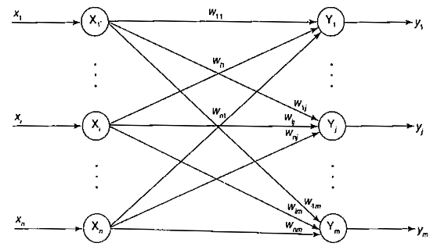
Learning Vector Quantization (Architecture)
Figure shows the architecture of LVQ, which is almost the same as that of KSOFM, with the difference being that in the case of LVQ, the topological structure at the output unit is not being considered.
Here each output unit has knowledge about what a known class represents.
From figure it can be noticed that there exist input layer with “n” units and output layer with “m” units.
The layers are found to be fully interconnected with weighted linkage acting over the links.

Slide 4
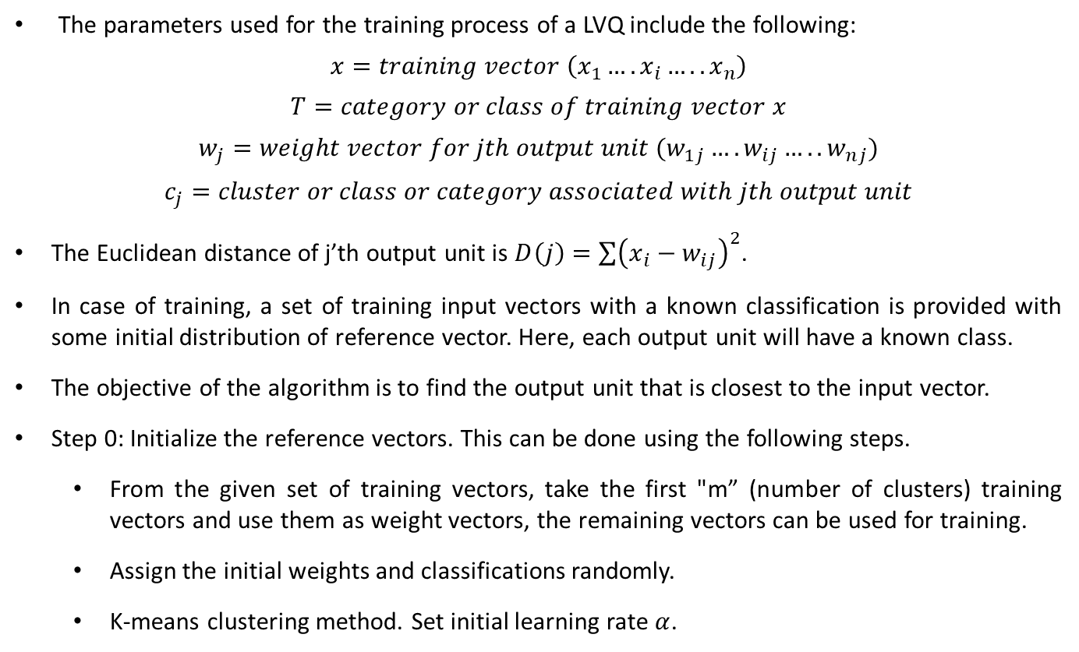
LVQ Training Algorithm
The parameters used for the training process of a LVQ include the following:
$$x=training vector \left(x_{1}….x_{i}…..x_{n}\right)$$
$$T=category or class of training vector x$$
$$w_{j}=weight vector for jth output unit (w_{1j}….w_{ij}…..w_{nj})$$
$$c_{j}=cluster or class or category associated with jth output unit$$
The Euclidean distance of j’th output unit is $D\left(j\right)=\sum{{\left(x_{i}−w_{ij}\right)}^{2}}$.
In case of training, a set of training input vectors with a known classification is provided with some initial distribution of reference vector. Here, each output unit will have a known class.
The objective of the algorithm is to find the output unit that is closest to the input vector.
Step 0: Initialize the reference vectors. This can be done using the following steps.
From the given set of training vectors, take the first "m” (number of clusters) training vectors and use them as weight vectors, the remaining vectors can be used for training.
Assign the initial weights and classifications randomly.
K-means clustering method. Set initial learning rate $α$.

Slide 5
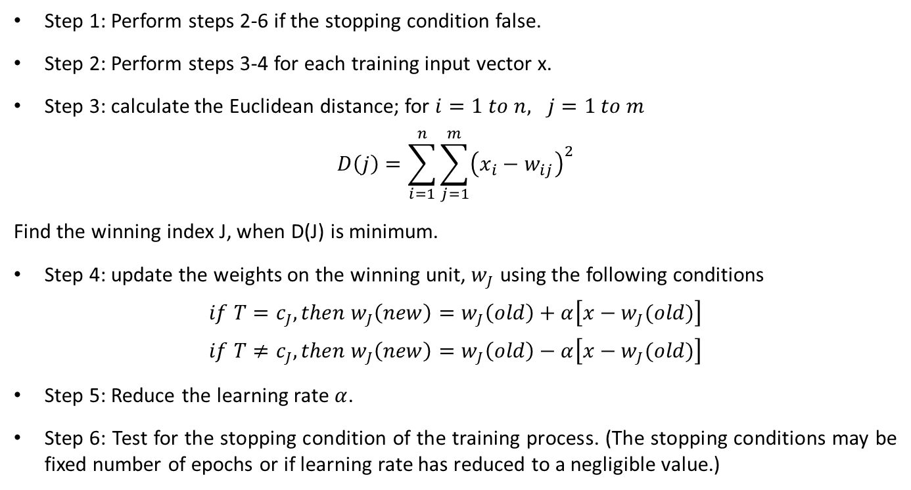
LVQ Training Algorithm
Step 1: Perform steps 2-6 if the stopping condition false.
Step 2: Perform steps 3-4 for each training input vector x.
Step 3: calculate the Euclidean distance; for $i=1 to n, j=1 to m$
$$D\left(j\right)=\sum_{i=1}^{n}{\sum_{j=1}^{m}{{\left(x_{i}−w_{ij}\right)}^{2}}}$$
Find the winning index J, when D(J) is minimum.
Step 4: update the weights on the winning unit, $w_{J}$ using the following conditions
$$if T=c_{J}, then w_{J}\left(new\right)=w_{J}\left(old\right)+α\left[x−w_{J}(old)\right]$$
$$if T≠c_{J}, then w_{J}\left(new\right)=w_{J}\left(old\right)−α\left[x−w_{J}(old)\right]$$
Step 5: Reduce the learning rate $α$.
Step 6: Test for the stopping condition of the training process. (The stopping conditions may be fixed number of epochs or if learning rate has reduced to a negligible value.)

Slide 6
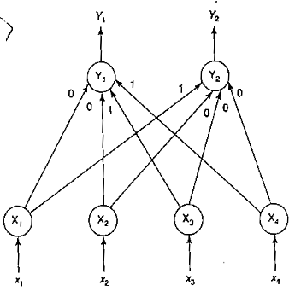
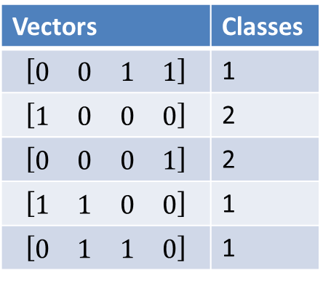
LVQ Example
Construct and test an LVQ net with five vectors assigned to two classes. The given vectors along with classes are as shown in table
Vectors | Classes
$$\left[\begin{matrix}\begin{matrix}0 & 0\end{matrix} & \begin{matrix}1 & 1\end{matrix}\end{matrix}\right]$$ | 1
$$\left[\begin{matrix}\begin{matrix}1 & 0\end{matrix} & \begin{matrix}0 & 0\end{matrix}\end{matrix}\right]$$ | 2
$$\left[\begin{matrix}\begin{matrix}0 & 0\end{matrix} & \begin{matrix}0 & 1\end{matrix}\end{matrix}\right]$$ | 2
$$\left[\begin{matrix}\begin{matrix}1 & 1\end{matrix} & \begin{matrix}0 & 0\end{matrix}\end{matrix}\right]$$ | 1
$$\left[\begin{matrix}\begin{matrix}0 & 1\end{matrix} & \begin{matrix}1 & 0\end{matrix}\end{matrix}\right]$$ | 1
In the given five vectors, first two vectors are used as initial weight vectors and the remaining three vectors are used as input vectors.
Based on this, LVQ net is shown in figure along with initial weights.

Slide 7
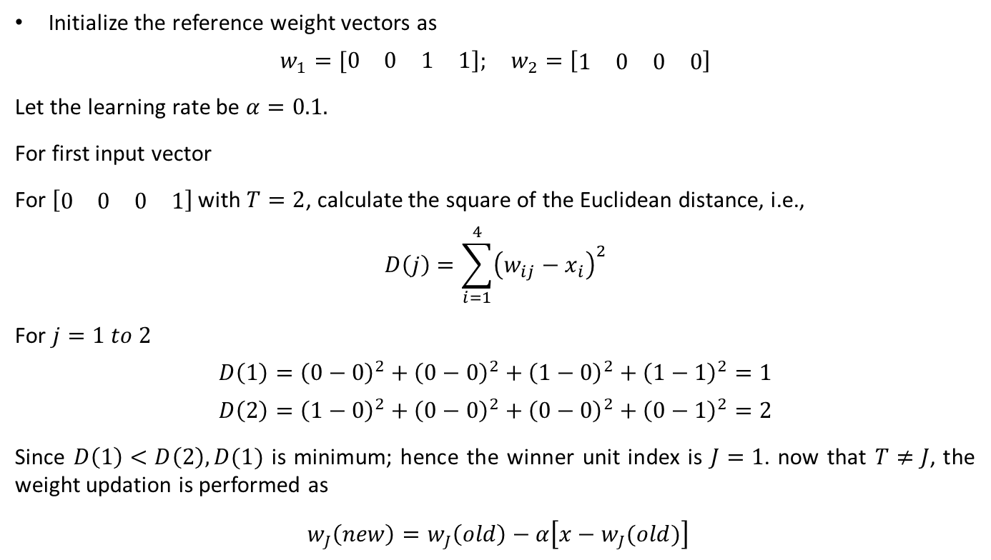
LVQ Example
Initialize the reference weight vectors as
$$w_{1}=[\begin{matrix}\begin{matrix}0 & 0\end{matrix} & \begin{matrix}1 & 1\end{matrix}]\end{matrix}; w_{2}=\left[\begin{matrix}\begin{matrix}1 & 0\end{matrix} & \begin{matrix}0 & 0\end{matrix}\end{matrix}\right]$$
Let the learning rate be $α=0.1.$
For first input vector
For $\left[\begin{matrix}\begin{matrix}0 & 0\end{matrix} & \begin{matrix}0 & 1\end{matrix}\end{matrix}\right]$ with $T=2$, calculate the square of the Euclidean distance, i.e.,
$$D\left(j\right)=\sum_{i=1}^{4}{{\left(w_{ij}−x_{i}\right)}^{2}}$$
For $j=1 to 2$
$$D\left(1\right)={\left(0−0\right)}^{2}+{\left(0−0\right)}^{2}+{\left(1−0\right)}^{2}+{\left(1−1\right)}^{2}=1$$
$$D\left(2\right)={\left(1−0\right)}^{2}+{\left(0−0\right)}^{2}+{\left(0−0\right)}^{2}+{\left(0−1\right)}^{2}=2$$
Since $D\left(1\right)<D\left(2\right), D(1)$ is minimum; hence the winner unit index is $J=1$. now that $T≠J$, the weight updation is performed as
$w_{J}\left(new\right)=w_{J}\left(old\right)−α\left[x−w_{J}(old)\right]$

Slide 8
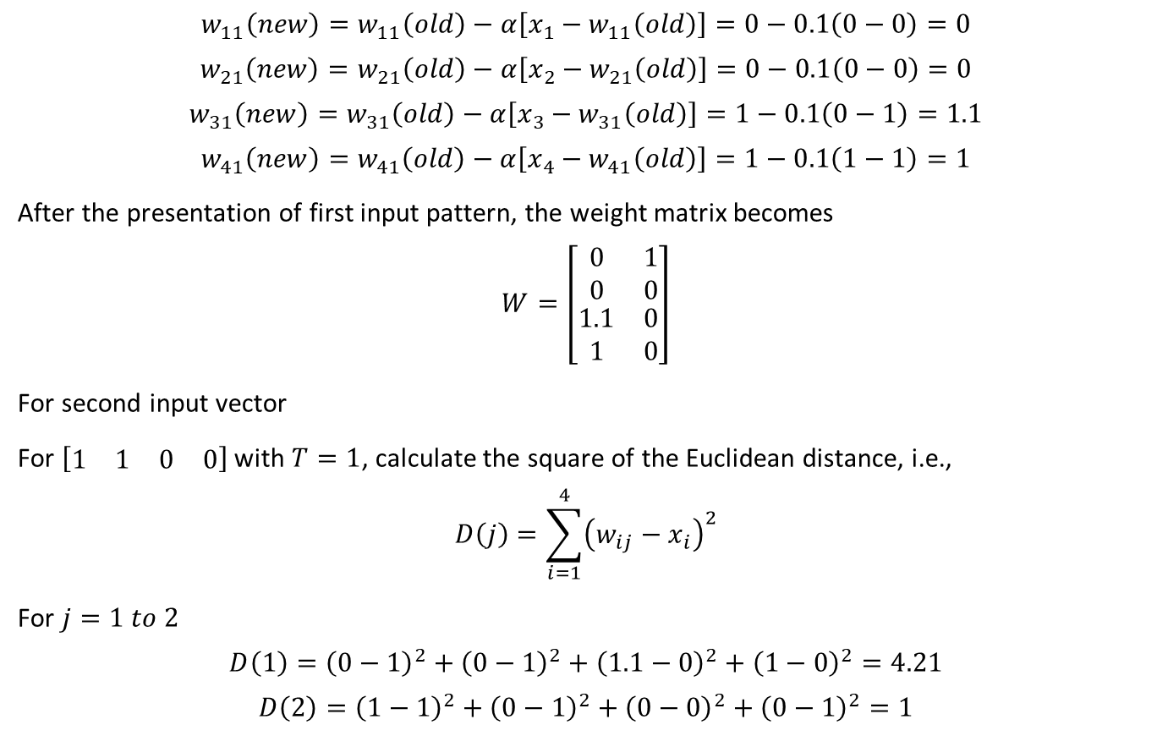
LVQ Example
$$w_{11}\left(new\right)=w_{11}\left(old\right)−α\left[x_{1}−w_{11}\left(old\right)\right]=0−0.1\left(0−0\right)=0$$
$$w_{21}\left(new\right)=w_{21}\left(old\right)−α\left[x_{2}−w_{21}\left(old\right)\right]=0−0.1\left(0−0\right)=0$$
$$w_{31}\left(new\right)=w_{31}\left(old\right)−α\left[x_{3}−w_{31}\left(old\right)\right]=1−0.1\left(0−1\right)=1.1$$
$$w_{41}\left(new\right)=w_{41}\left(old\right)−α\left[x_{4}−w_{41}\left(old\right)\right]=1−0.1\left(1−1\right)=1$$
After the presentation of first input pattern, the weight matrix becomes
$$W=\left[\begin{matrix}\begin{matrix}\begin{matrix}0 \\ 0\end{matrix} \\ \begin{matrix}1.1 \\ 1\end{matrix}\end{matrix} & \begin{matrix}\begin{matrix}1 \\ 0\end{matrix} \\ \begin{matrix}0 \\ 0\end{matrix}\end{matrix}\end{matrix}\right]$$
For second input vector
For $\left[\begin{matrix}\begin{matrix}1 & 1\end{matrix} & \begin{matrix}0 & 0\end{matrix}\end{matrix}\right]$ with $T=1$, calculate the square of the Euclidean distance, i.e.,
$$D\left(j\right)=\sum_{i=1}^{4}{{\left(w_{ij}−x_{i}\right)}^{2}}$$
For $j=1 to 2$
$$D\left(1\right)={\left(0−1\right)}^{2}+{\left(0−1\right)}^{2}+{\left(1.1−0\right)}^{2}+{\left(1−0\right)}^{2}=4.21$$
$$D\left(2\right)={\left(1−1\right)}^{2}+{\left(0−1\right)}^{2}+{\left(0−0\right)}^{2}+{\left(0−1\right)}^{2}=1$$

Slide 9
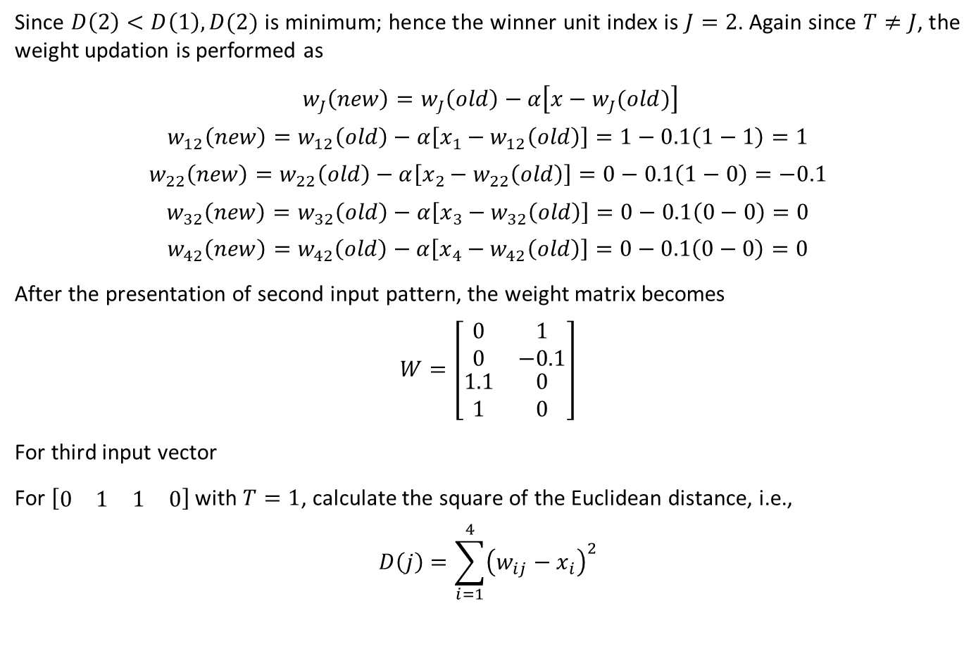
LVQ Example
Since $D\left(2\right)<D\left(1\right), D(2)$ is minimum; hence the winner unit index is $J=2$. Again since $T≠J$, the weight updation is performed as
$w_{J}\left(new\right)=w_{J}\left(old\right)−α\left[x−w_{J}(old)\right]$
$$w_{12}\left(new\right)=w_{12}\left(old\right)−α\left[x_{1}−w_{12}\left(old\right)\right]=1−0.1\left(1−1\right)=1$$
$$w_{22}\left(new\right)=w_{22}\left(old\right)−α\left[x_{2}−w_{22}\left(old\right)\right]=0−0.1\left(1−0\right)=−0.1$$
$$w_{32}\left(new\right)=w_{32}\left(old\right)−α\left[x_{3}−w_{32}\left(old\right)\right]=0−0.1\left(0−0\right)=0$$
$$w_{42}\left(new\right)=w_{42}\left(old\right)−α\left[x_{4}−w_{42}\left(old\right)\right]=0−0.1\left(0−0\right)=0$$
After the presentation of second input pattern, the weight matrix becomes
$$W=\left[\begin{matrix}\begin{matrix}\begin{matrix}0 \\ 0\end{matrix} \\ \begin{matrix}1.1 \\ 1\end{matrix}\end{matrix} & \begin{matrix}\begin{matrix}1 \\ −0.1\end{matrix} \\ \begin{matrix}0 \\ 0\end{matrix}\end{matrix}\end{matrix}\right]$$
For third input vector
For $\left[\begin{matrix}\begin{matrix}0 & 1\end{matrix} & \begin{matrix}1 & 0\end{matrix}\end{matrix}\right]$ with $T=1$, calculate the square of the Euclidean distance, i.e.,
$$D\left(j\right)=\sum_{i=1}^{4}{{\left(w_{ij}−x_{i}\right)}^{2}}$$

Slide 10
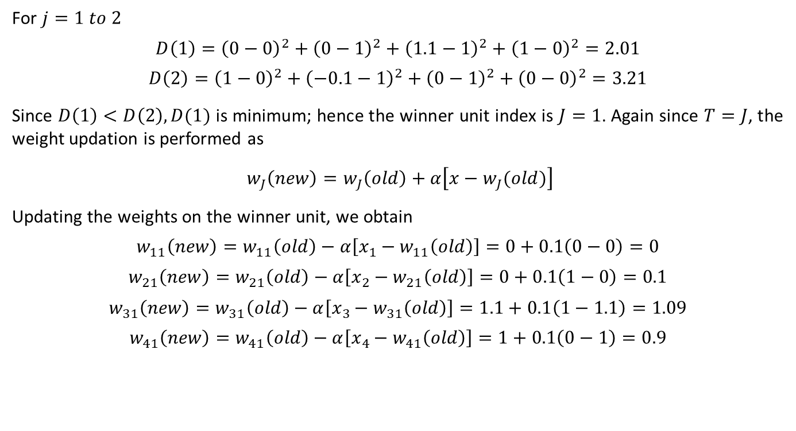
LVQ Example
For $j=1 to 2$
$$D\left(1\right)={\left(0−0\right)}^{2}+{\left(0−1\right)}^{2}+{\left(1.1−1\right)}^{2}+{\left(1−0\right)}^{2}=2.01$$
$$D\left(2\right)={\left(1−0\right)}^{2}+{\left(−0.1−1\right)}^{2}+{\left(0−1\right)}^{2}+{\left(0−0\right)}^{2}=3.21$$
Since $D\left(1\right)<D\left(2\right), D(1)$ is minimum; hence the winner unit index is $J=1$. Again since $T=J$, the weight updation is performed as
$w_{J}\left(new\right)=w_{J}\left(old\right)+α\left[x−w_{J}(old)\right]$
Updating the weights on the winner unit, we obtain
$$w_{11}\left(new\right)=w_{11}\left(old\right)−α\left[x_{1}−w_{11}\left(old\right)\right]=0+0.1\left(0−0\right)=0$$
$$w_{21}\left(new\right)=w_{21}\left(old\right)−α\left[x_{2}−w_{21}\left(old\right)\right]=0+0.1\left(1−0\right)=0.1$$
$$w_{31}\left(new\right)=w_{31}\left(old\right)−α\left[x_{3}−w_{31}\left(old\right)\right]=1.1+0.1\left(1−1.1\right)=1.09$$
$$w_{41}\left(new\right)=w_{41}\left(old\right)−α\left[x_{4}−w_{41}\left(old\right)\right]=1+0.1\left(0−1\right)=0.9$$

Slide 11
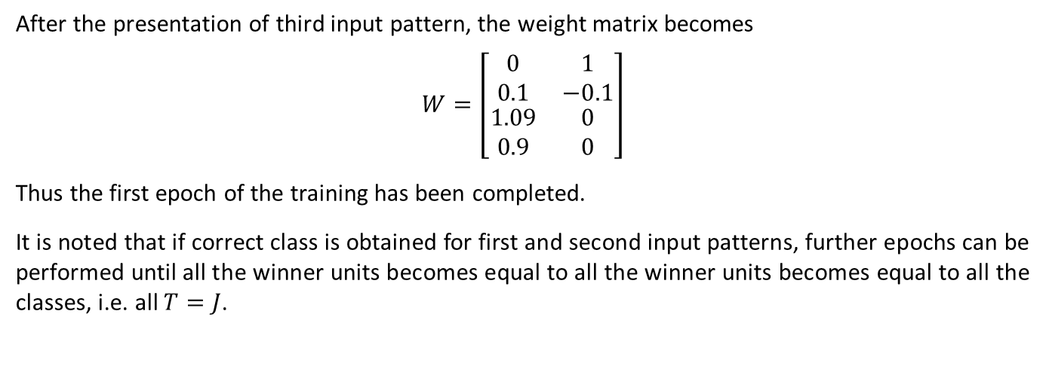
LVQ Example
After the presentation of third input pattern, the weight matrix becomes
$$W=\left[\begin{matrix}\begin{matrix}\begin{matrix}0 \\ 0.1\end{matrix} \\ \begin{matrix}1.09 \\ 0.9\end{matrix}\end{matrix} & \begin{matrix}\begin{matrix}1 \\ −0.1\end{matrix} \\ \begin{matrix}0 \\ 0\end{matrix}\end{matrix}\end{matrix}\right]$$
Thus the first epoch of the training has been completed.
It is noted that if correct class is obtained for first and second input patterns, further epochs can be performed until all the winner units becomes equal to all the winner units becomes equal to all the classes, i.e. all $T=J$.

Slide 12
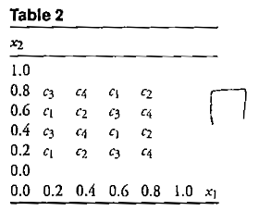
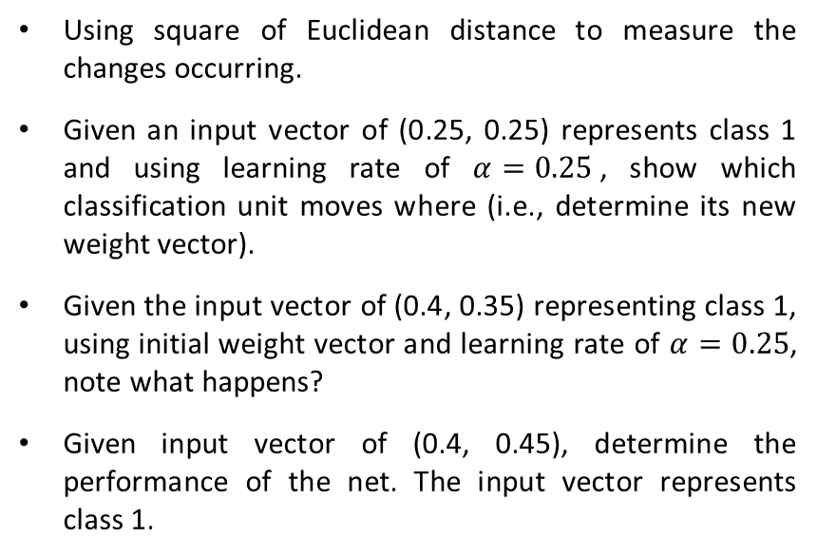
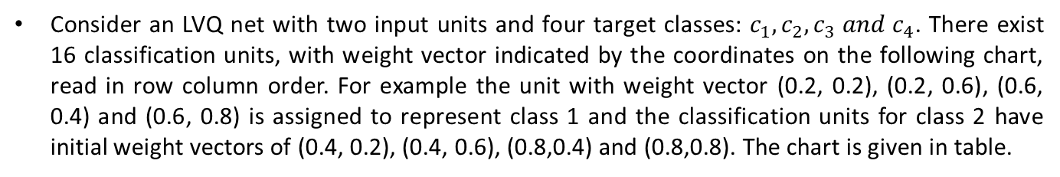
LVQ Example
Consider an LVQ net with two input units and four target classes: $c_{1}, c_{2}, c_{3} and c_{4}$. There exist 16 classification units, with weight vector indicated by the coordinates on the following chart, read in row column order. For example the unit with weight vector (0.2, 0.2), (0.2, 0.6), (0.6, 0.4) and (0.6, 0.8) is assigned to represent class 1 and the classification units for class 2 have initial weight vectors of (0.4, 0.2), (0.4, 0.6), (0.8,0.4) and (0.8,0.8). The chart is given in table.
Using square of Euclidean distance to measure the changes occurring.
Given an input vector of (0.25, 0.25) represents class 1 and using learning rate of $α=0.25$, show which classification unit moves where (i.e., determine its new weight vector).
Given the input vector of (0.4, 0.35) representing class 1, using initial weight vector and learning rate of $α=0.25$, note what happens?
Given input vector of (0.4, 0.45), determine the performance of the net. The input vector represents class 1.

Slide 13
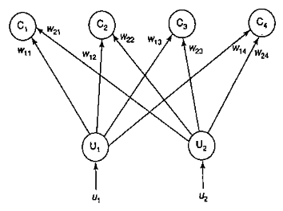
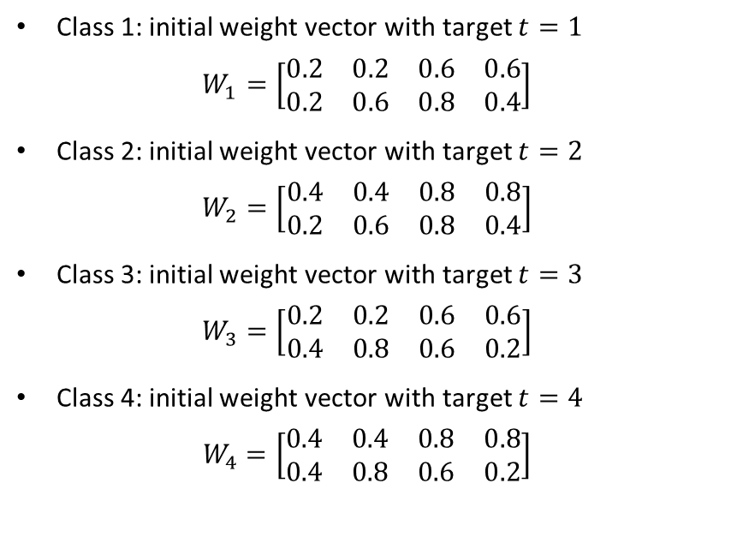
LVQ Example
Solution:
The LVQ net for this problem with two input units and four cluster units is shown in figure. The initial weight vectors for representative classes are shown below.
Class 1: initial weight vector with target $t=1$
$$W_{1}=\left[\begin{matrix}\begin{matrix}\begin{matrix}0.2 & 0.2\end{matrix} & \begin{matrix}0.6 & 0.6\end{matrix}\end{matrix} \\ \begin{matrix}\begin{matrix}0.2 & 0.6\end{matrix} & \begin{matrix}0.8 & 0.4\end{matrix}\end{matrix}\end{matrix}\right]$$
Class 2: initial weight vector with target $t=2$
$$W_{2}=\left[\begin{matrix}\begin{matrix}\begin{matrix}0.4 & 0.4\end{matrix} & \begin{matrix}0.8 & 0.8\end{matrix}\end{matrix} \\ \begin{matrix}\begin{matrix}0.2 & 0.6\end{matrix} & \begin{matrix}0.8 & 0.4\end{matrix}\end{matrix}\end{matrix}\right]$$
Class 3: initial weight vector with target $t=3$
$$W_{3}=\left[\begin{matrix}\begin{matrix}\begin{matrix}0.2 & 0.2\end{matrix} & \begin{matrix}0.6 & 0.6\end{matrix}\end{matrix} \\ \begin{matrix}\begin{matrix}0.4 & 0.8\end{matrix} & \begin{matrix}0.6 & 0.2\end{matrix}\end{matrix}\end{matrix}\right]$$
Class 4: initial weight vector with target $t=4$
$$W_{4}=\left[\begin{matrix}\begin{matrix}\begin{matrix}0.4 & 0.4\end{matrix} & \begin{matrix}0.8 & 0.8\end{matrix}\end{matrix} \\ \begin{matrix}\begin{matrix}0.4 & 0.8\end{matrix} & \begin{matrix}0.6 & 0.2\end{matrix}\end{matrix}\end{matrix}\right]$$

Slide 14
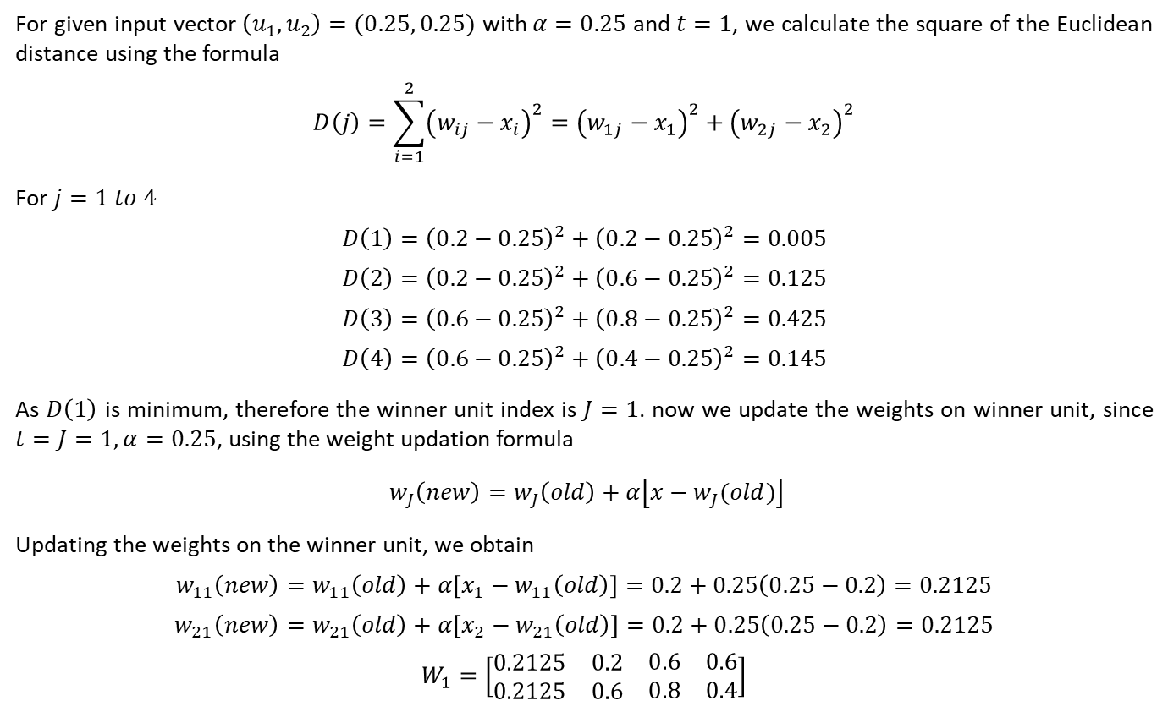
LVQ Example
For given input vector $\left(u_{1}, u_{2}\right)=(0.25, 0.25)$ with $α=0.25$ and $t=1$, we calculate the square of the Euclidean distance using the formula
$$D\left(j\right)=\sum_{i=1}^{2}{{\left(w_{ij}−x_{i}\right)}^{2}={\left(w_{1j}−x_{1}\right)}^{2}+{\left(w_{2j}−x_{2}\right)}^{2}}$$
For $j=1 to 4$
$$D\left(1\right)={\left(0.2−0.25\right)}^{2}+{\left(0.2−0.25\right)}^{2}=0.005$$
$$D\left(2\right)={\left(0.2−0.25\right)}^{2}+{\left(0.6−0.25\right)}^{2}=0.125$$
$$D\left(3\right)={\left(0.6−0.25\right)}^{2}+{\left(0.8−0.25\right)}^{2}=0.425$$
$$D\left(4\right)={\left(0.6−0.25\right)}^{2}+{\left(0.4−0.25\right)}^{2}=0.145$$
As $D\left(1\right)$ is minimum, therefore the winner unit index is $J=1$. now we update the weights on winner unit, since $t=J=1, α=0.25$, using the weight updation formula
$w_{J}\left(new\right)=w_{J}\left(old\right)+α\left[x−w_{J}(old)\right]$
Updating the weights on the winner unit, we obtain
$$w_{11}\left(new\right)=w_{11}\left(old\right)+α\left[x_{1}−w_{11}\left(old\right)\right]=0.2+0.25\left(0.25−0.2\right)=0.2125$$
$$w_{21}\left(new\right)=w_{21}\left(old\right)+α\left[x_{2}−w_{21}\left(old\right)\right]=0.2+0.25\left(0.25−0.2\right)=0.2125$$
$$W_{1}=\left[\begin{matrix}\begin{matrix}\begin{matrix}0.2125 & 0.2\end{matrix} & \begin{matrix}0.6 & 0.6\end{matrix}\end{matrix} \\ \begin{matrix}\begin{matrix}0.2125 & 0.6\end{matrix} & \begin{matrix}0.8 & 0.4\end{matrix}\end{matrix}\end{matrix}\right]$$

Slide 15
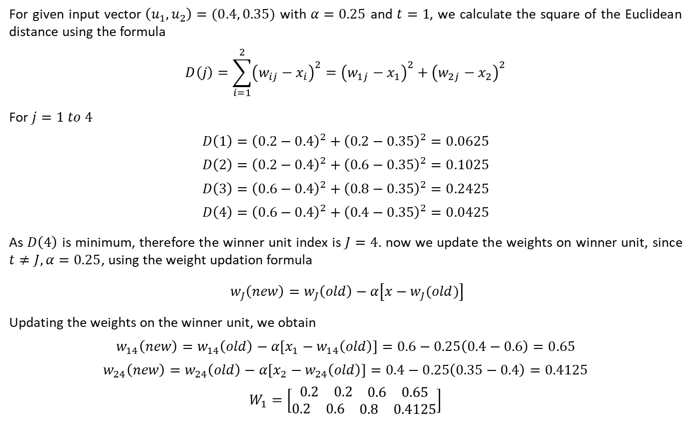
LVQ Example
For given input vector $\left(u_{1}, u_{2}\right)=(0.4, 0.35)$ with $α=0.25$ and $t=1$, we calculate the square of the Euclidean distance using the formula
$$D\left(j\right)=\sum_{i=1}^{2}{{\left(w_{ij}−x_{i}\right)}^{2}={\left(w_{1j}−x_{1}\right)}^{2}+{\left(w_{2j}−x_{2}\right)}^{2}}$$
For $j=1 to 4$
$$D\left(1\right)={\left(0.2−0.4\right)}^{2}+{\left(0.2−0.35\right)}^{2}=0.0625$$
$$D\left(2\right)={\left(0.2−0.4\right)}^{2}+{\left(0.6−0.35\right)}^{2}=0.1025$$
$$D\left(3\right)={\left(0.6−0.4\right)}^{2}+{\left(0.8−0.35\right)}^{2}=0.2425$$
$$D\left(4\right)={\left(0.6−0.4\right)}^{2}+{\left(0.4−0.35\right)}^{2}=0.0425$$
As $D\left(4\right)$ is minimum, therefore the winner unit index is $J=4$. now we update the weights on winner unit, since $t≠J, α=0.25$, using the weight updation formula
$w_{J}\left(new\right)=w_{J}\left(old\right)−α\left[x−w_{J}(old)\right]$
Updating the weights on the winner unit, we obtain
$$w_{14}\left(new\right)=w_{14}\left(old\right)−α\left[x_{1}−w_{14}\left(old\right)\right]=0.6−0.25\left(0.4−0.6\right)=0.65$$
$$w_{24}\left(new\right)=w_{24}\left(old\right)−α\left[x_{2}−w_{24}\left(old\right)\right]=0.4−0.25\left(0.35−0.4\right)=0.4125$$
$$W_{1}=\left[\begin{matrix}\begin{matrix}\begin{matrix}0.2 & 0.2\end{matrix} & \begin{matrix}0.6 & 0.65\end{matrix}\end{matrix} \\ \begin{matrix}\begin{matrix}0.2 & 0.6\end{matrix} & \begin{matrix}0.8 & 0.4125\end{matrix}\end{matrix}\end{matrix}\right]$$

Slide 16
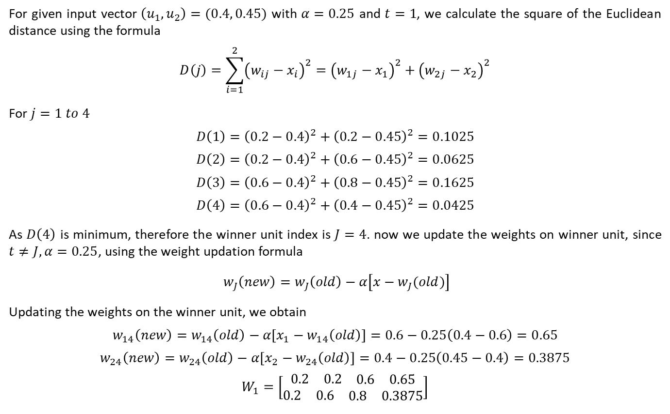
LVQ Example
For given input vector $\left(u_{1}, u_{2}\right)=(0.4, 0.45)$ with $α=0.25$ and $t=1$, we calculate the square of the Euclidean distance using the formula
$$D\left(j\right)=\sum_{i=1}^{2}{{\left(w_{ij}−x_{i}\right)}^{2}={\left(w_{1j}−x_{1}\right)}^{2}+{\left(w_{2j}−x_{2}\right)}^{2}}$$
For $j=1 to 4$
$$D\left(1\right)={\left(0.2−0.4\right)}^{2}+{\left(0.2−0.45\right)}^{2}=0.1025$$
$$D\left(2\right)={\left(0.2−0.4\right)}^{2}+{\left(0.6−0.45\right)}^{2}=0.0625$$
$$D\left(3\right)={\left(0.6−0.4\right)}^{2}+{\left(0.8−0.45\right)}^{2}=0.1625$$
$$D\left(4\right)={\left(0.6−0.4\right)}^{2}+{\left(0.4−0.45\right)}^{2}=0.0425$$
As $D\left(4\right)$ is minimum, therefore the winner unit index is $J=4$. now we update the weights on winner unit, since $t≠J, α=0.25$, using the weight updation formula
$w_{J}\left(new\right)=w_{J}\left(old\right)−α\left[x−w_{J}(old)\right]$
Updating the weights on the winner unit, we obtain
$$w_{14}\left(new\right)=w_{14}\left(old\right)−α\left[x_{1}−w_{14}\left(old\right)\right]=0.6−0.25\left(0.4−0.6\right)=0.65$$
$$w_{24}\left(new\right)=w_{24}\left(old\right)−α\left[x_{2}−w_{24}\left(old\right)\right]=0.4−0.25\left(0.45−0.4\right)=0.3875$$
$$W_{1}=\left[\begin{matrix}\begin{matrix}\begin{matrix}0.2 & 0.2\end{matrix} & \begin{matrix}0.6 & 0.65\end{matrix}\end{matrix} \\ \begin{matrix}\begin{matrix}0.2 & 0.6\end{matrix} & \begin{matrix}0.8 & 0.3875\end{matrix}\end{matrix}\end{matrix}\right]$$

Slide 17
Counter Propagation network
Counter-propagation networks were proposed by Hecht Nielsen in 1987. They are multilayer networks based on the combinations of the input, output and clustering layers.
The applications of counter-propagation nets are data compression, function approximation and pattern association.
The counter-propagation network is basically constructed from an instar--outstar model.
This model is a three-layer neural network that performs input-output data mapping, producing an output vector y in response to an input vector x, on the basis of competitive learning.
The three layers in an instar-outstar model are the input layer, the hidden (competitive) layer and the output layer.
The connections between the input layer and the competitive layer are the instar structure, and the connections existing between the competitive layer and the output layer are the outstar structure.
The competitive layer is going to be a winner-takes-all network or a Maxnet with lateral feedback connections.
There exists no lateral connection within the input layer and the output layer. The connections between the layers are fully connected.

Slide 18
Counter Propagation network
A counter-propagation net is an approximation of its training input vector pairs by adaptively constructing a look-up-table.
By this method, several data points can be compressed to a more manageable number of look-up-table entries.
The accuracy of the function approximation and data compression is based on the number of entries in the look-up-table, which equals the number of units in the cluster layer of the net.
There are two stages involved in the training process of a counter-propagation net.
The input vectors are clustered in the first stage. Originally, it is assumed that there is no topology included in the counter-propagation network. However, on the inclusion of a linear topology, the performance of the net can be improved. The clusters are formed using Euclidean distance method or dot product method.
In the second stage of training, the weights from the cluster layer units to the output units are tuned to obtain the desired response. There are two types of counter-propagation nets:
(i) Full counter-propagation net
(ii) forward-only counter-propagation net.

Slide 19
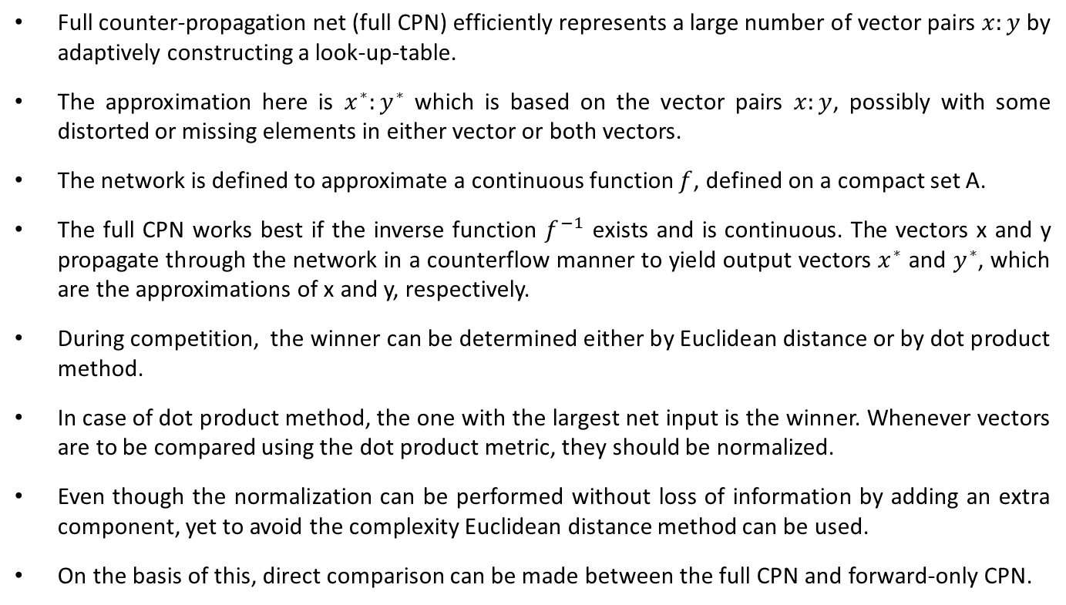
Full Counter Propagation network
Full counter-propagation net (full CPN) efficiently represents a large number of vector pairs $x:y$ by adaptively constructing a look-up-table.
The approximation here is $x^{∗}:y^{∗}$ which is based on the vector pairs $x:y$, possibly with some distorted or missing elements in either vector or both vectors.
The network is defined to approximate a continuous function $f$, defined on a compact set A.
The full CPN works best if the inverse function $f^{−1}$ exists and is continuous. The vectors x and y propagate through the network in a counterflow manner to yield output vectors $x^{∗}$ and $y^{∗}$, which are the approximations of x and y, respectively.
During competition, the winner can be determined either by Euclidean distance or by dot product method.
In case of dot product method, the one with the largest net input is the winner. Whenever vectors are to be compared using the dot product metric, they should be normalized.
Even though the normalization can be performed without loss of information by adding an extra component, yet to avoid the complexity Euclidean distance method can be used.
On the basis of this, direct comparison can be made between the full CPN and forward-only CPN.

Slide 21
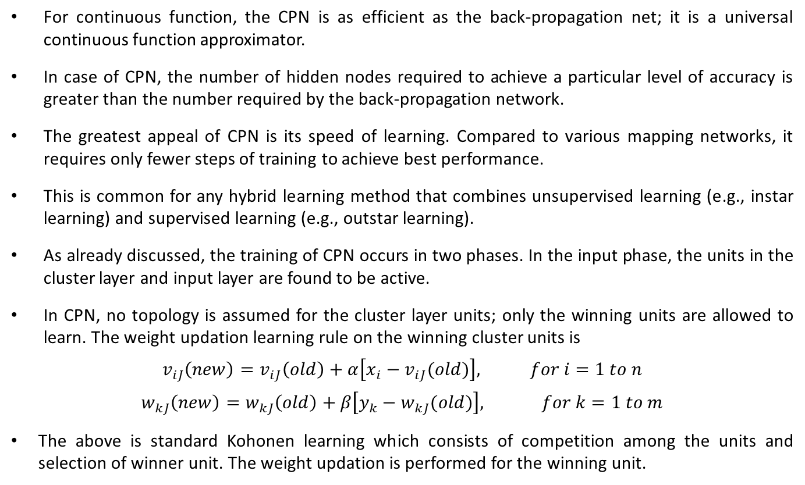
Full Counter Propagation network
For continuous function, the CPN is as efficient as the back-propagation net; it is a universal continuous function approximator.
In case of CPN, the number of hidden nodes required to achieve a particular level of accuracy is greater than the number required by the back-propagation network.
The greatest appeal of CPN is its speed of learning. Compared to various mapping networks, it requires only fewer steps of training to achieve best performance.
This is common for any hybrid learning method that combines unsupervised learning (e.g., instar learning) and supervised learning (e.g., outstar learning).
As already discussed, the training of CPN occurs in two phases. In the input phase, the units in the cluster layer and input layer are found to be active.
In CPN, no topology is assumed for the cluster layer units; only the winning units are allowed to learn. The weight updation learning rule on the winning cluster units is
$$v_{iJ}\left(new\right)=v_{iJ}\left(old\right)+α\left[x_{i}−v_{iJ}(old)\right], for i=1 to n$$
$$w_{kJ}\left(new\right)=w_{kJ}\left(old\right)+β\left[y_{k}−w_{kJ}(old)\right], for k=1 to m$$
The above is standard Kohonen learning which consists of competition among the units and selection of winner unit. The weight updation is performed for the winning unit.

Slide 22
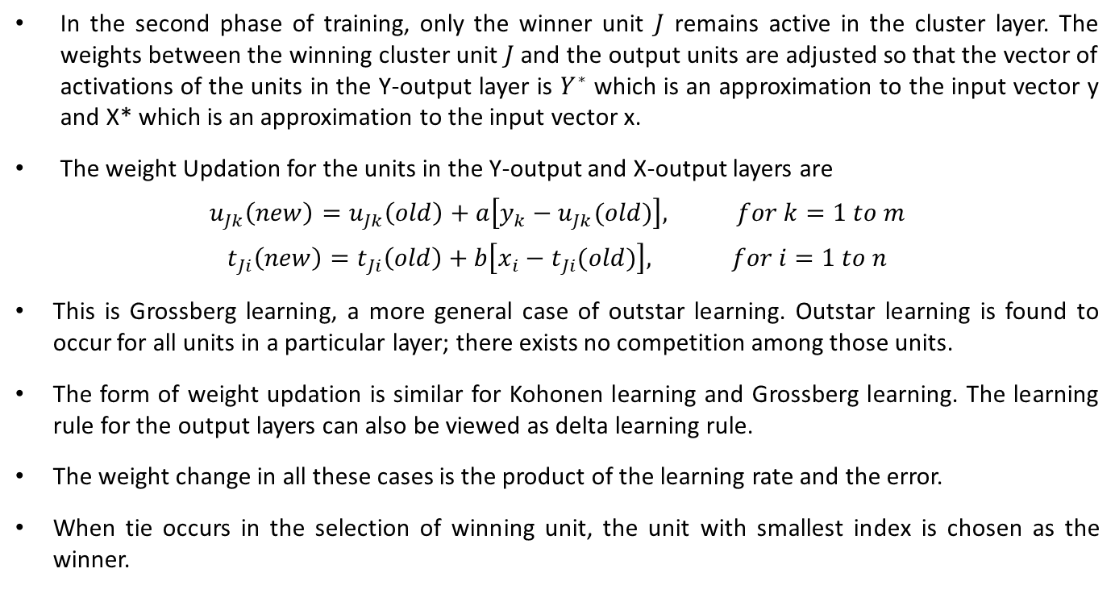
Full Counter Propagation network
In the second phase of training, only the winner unit $J$ remains active in the cluster layer. The weights between the winning cluster unit $J$ and the output units are adjusted so that the vector of activations of the units in the Y-output layer is $Y^{∗}$ which is an approximation to the input vector y and X* which is an approximation to the input vector x.
The weight Updation for the units in the Y-output and X-output layers are
$$u_{Jk}\left(new\right)=u_{Jk}\left(old\right)+a\left[y_{k}−u_{Jk}(old)\right], for k=1 to m$$
$$t_{Ji}\left(new\right)=t_{Ji}\left(old\right)+b\left[x_{i}−t_{Ji}(old)\right], for i=1 to n$$
This is Grossberg learning, a more general case of outstar learning. Outstar learning is found to occur for all units in a particular layer; there exists no competition among those units.
The form of weight updation is similar for Kohonen learning and Grossberg learning. The learning rule for the output layers can also be viewed as delta learning rule.
The weight change in all these cases is the product of the learning rate and the error.
When tie occurs in the selection of winning unit, the unit with smallest index is chosen as the winner.

Slide 23
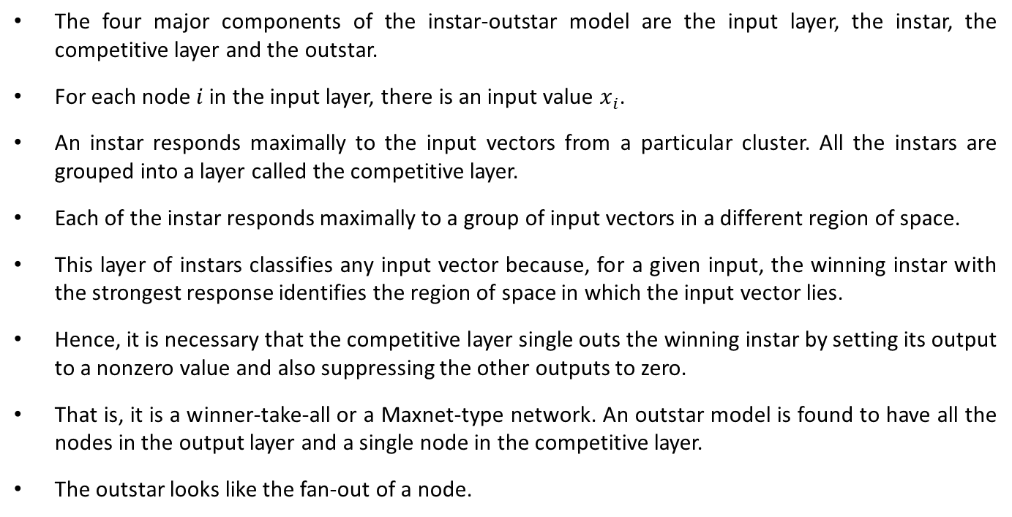
Full CPN (Architecture)
The four major components of the instar-outstar model are the input layer, the instar, the competitive layer and the outstar.
For each node$i$in the input layer, there is an input value $x_{i}$.
An instar responds maximally to the input vectors from a particular cluster. All the instars are grouped into a layer called the competitive layer.
Each of the instar responds maximally to a group of input vectors in a different region of space.
This layer of instars classifies any input vector because, for a given input, the winning instar with the strongest response identifies the region of space in which the input vector lies.
Hence, it is necessary that the competitive layer single outs the winning instar by setting its output to a nonzero value and also suppressing the other outputs to zero.
That is, it is a winner-take-all or a Maxnet-type network. An outstar model is found to have all the nodes in the output layer and a single node in the competitive layer.
The outstar looks like the fan-out of a node.

Slide 24
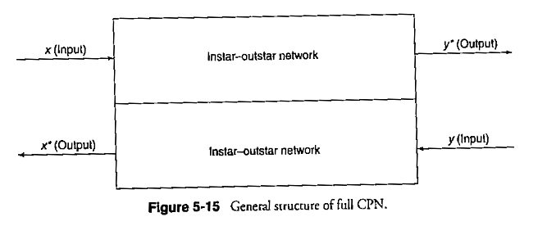
Full CPN (Architecture)
In the instar-outstar network model, the competitive layer participates in both the instar and outstar structures of the network.
The function of these competitive instars is to recognize an input pattern through a winner-rake-all competition.
The winner activates a corresponding outstar which associates some desired output pattern with input pattern.

Slide 25
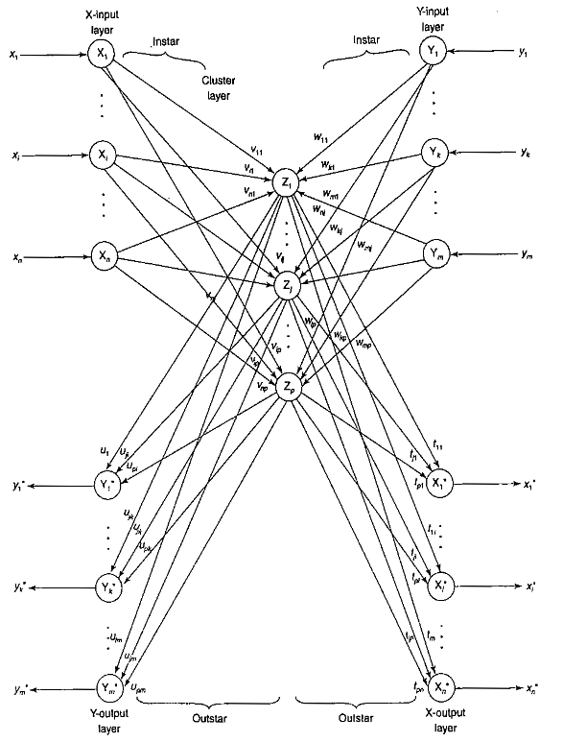

Slide 26
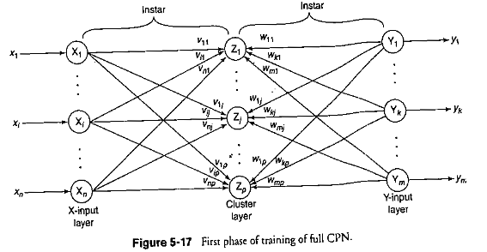

Slide 27
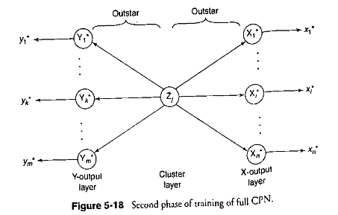

Slide 28
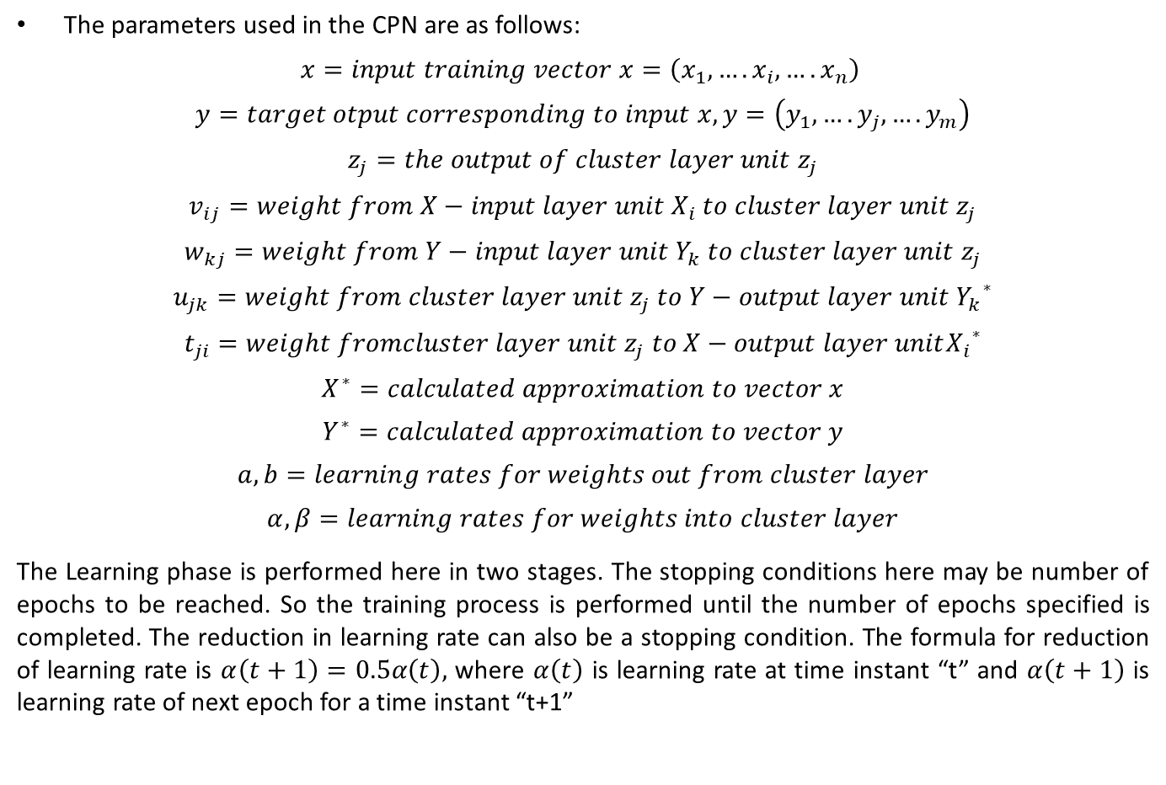
Full CPN (Training Process)
The parameters used in the CPN are as follows:
$$x=input training vector x=\left(x_{1},….x_{i},….x_{n}\right)$$
$$y=target otput corresponding to input x,y=\left(y_{1},….y_{j},….y_{m}\right)$$
$$z_{j}=the output of cluster layer unit z_{j}$$
$$v_{ij}=weight from X−input layer unit X_{i} to cluster layer unit z_{j}$$
$$w_{kj}=weight from Y−input layer unit Y_{k} to cluster layer unit z_{j}$$
$$u_{jk}=weight from cluster layer unit z_{j} to Y−output layer unit {Y_{k}}^{∗}$$
$$t_{ji}=weight fromcluster layer unit z_{j} to X−output layer unit{X_{i}}^{∗}$$
$$X^{∗}=calculated approximation to vector x$$
$$Y^{∗}=calculated approximation to vector y$$
$$a,b=learning rates for weights out from cluster layer$$
$$α, β=learning rates for weights into cluster layer$$
The Learning phase is performed here in two stages. The stopping conditions here may be number of epochs to be reached. So the training process is performed until the number of epochs specified is completed. The reduction in learning rate can also be a stopping condition. The formula for reduction of learning rate is $α\left(t+1\right)=0.5α\left(t\right),$ where $α\left(t\right)$ is learning rate at time instant “t” and $α\left(t+1\right)$ is learning rate of next epoch for a time instant “t+1”

Slide 29
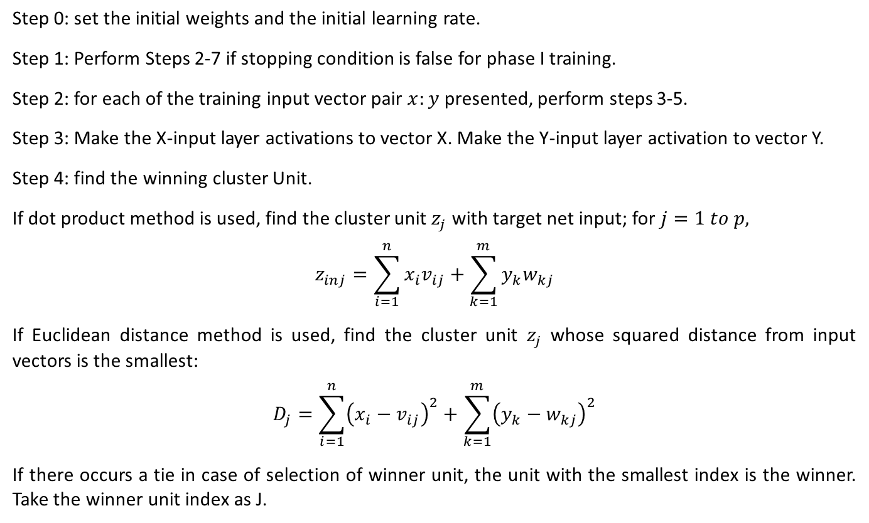
Training Algorithm
Step 0: set the initial weights and the initial learning rate.
Step 1: Perform Steps 2-7 if stopping condition is false for phase I training.
Step 2: for each of the training input vector pair $x:y$ presented, perform steps 3-5.
Step 3: Make the X-input layer activations to vector X. Make the Y-input layer activation to vector Y.
Step 4: find the winning cluster Unit.
If dot product method is used, find the cluster unit $z_{j}$ with target net input; for $j=1 to p,$
$$z_{inj}=\sum_{i=1}^{n}{x_{i}v_{ij}}+\sum_{k=1}^{m}{y_{k}w_{kj}}$$
If Euclidean distance method is used, find the cluster unit $z_{j}$ whose squared distance from input vectors is the smallest:
$$D_{j}=\sum_{i=1}^{n}{{\left(x_{i}−v_{ij}\right)}^{2}}+\sum_{k=1}^{m}{{\left(y_{k}−w_{kj}\right)}^{2}}$$
If there occurs a tie in case of selection of winner unit, the unit with the smallest index is the winner. Take the winner unit index as J.

Slide 30
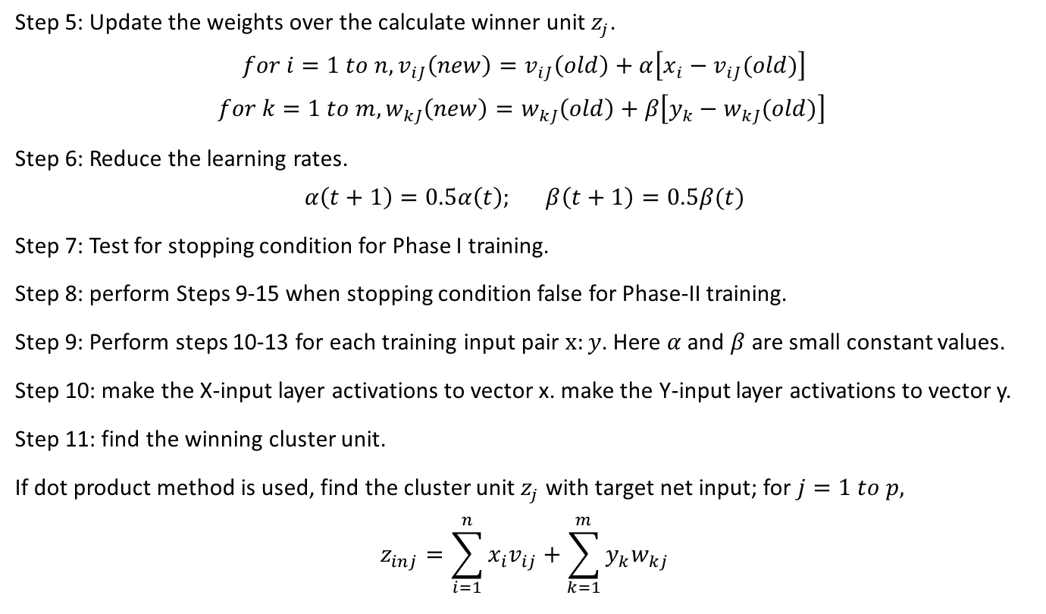
Training Algorithm
Step 5: Update the weights over the calculate winner unit $z_{j}$.
$$for i=1 to n, v_{iJ}\left(new\right)=v_{iJ}\left(old\right)+α\left[x_{i}−v_{iJ}(old)\right]$$
$$for k=1 to m, w_{kJ}\left(new\right)=w_{kJ}\left(old\right)+β\left[y_{k}−w_{kJ}(old)\right]$$
Step 6: Reduce the learning rates.
$$α\left(t+1\right)=0.5α\left(t\right); β\left(t+1\right)=0.5β(t)$$
Step 7: Test for stopping condition for Phase I training.
Step 8: perform Steps 9-15 when stopping condition false for Phase-II training.
Step 9: Perform steps 10-13 for each training input pair $x:y$. Here $α$ and $β$ are small constant values.
Step 10: make the X-input layer activations to vector x. make the Y-input layer activations to vector y.
Step 11: find the winning cluster unit.
If dot product method is used, find the cluster unit $z_{j}$ with target net input; for $j=1 to p,$
$$z_{inj}=\sum_{i=1}^{n}{x_{i}v_{ij}}+\sum_{k=1}^{m}{y_{k}w_{kj}}$$

Slide 31
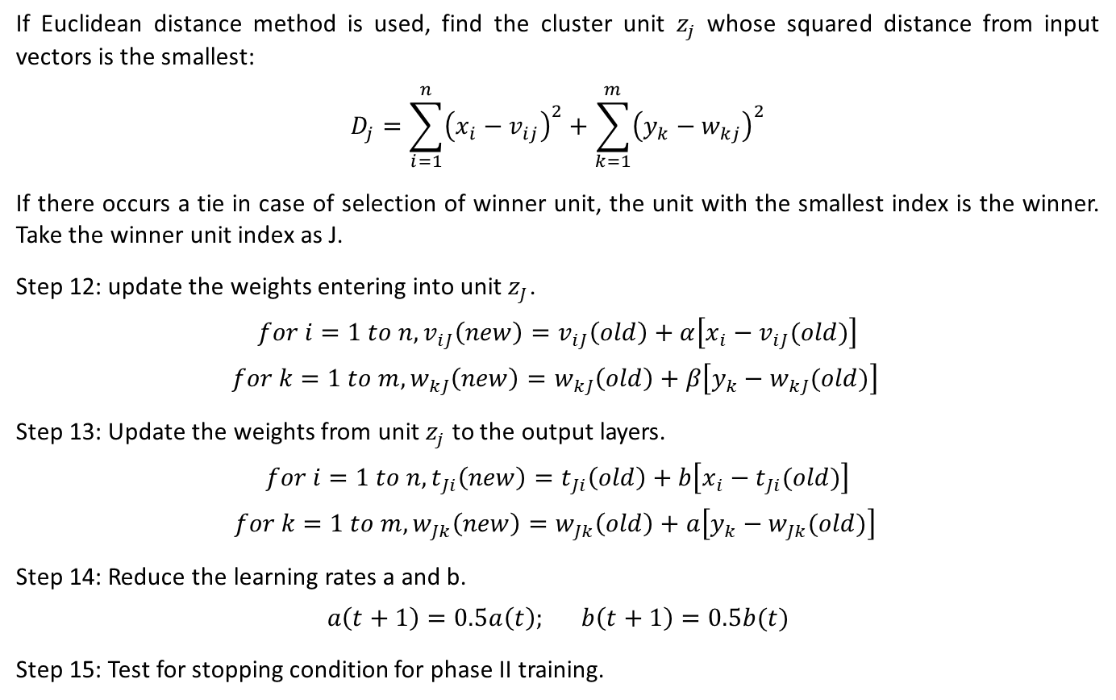
Training Algorithm
If Euclidean distance method is used, find the cluster unit $z_{j}$ whose squared distance from input vectors is the smallest:
$$D_{j}=\sum_{i=1}^{n}{{\left(x_{i}−v_{ij}\right)}^{2}}+\sum_{k=1}^{m}{{\left(y_{k}−w_{kj}\right)}^{2}}$$
If there occurs a tie in case of selection of winner unit, the unit with the smallest index is the winner. Take the winner unit index as J.
Step 12: update the weights entering into unit $z_{J}$.
$$for i=1 to n, v_{iJ}\left(new\right)=v_{iJ}\left(old\right)+α\left[x_{i}−v_{iJ}(old)\right]$$
$$for k=1 to m, w_{kJ}\left(new\right)=w_{kJ}\left(old\right)+β\left[y_{k}−w_{kJ}(old)\right]$$
Step 13: Update the weights from unit $z_{j}$ to the output layers.
$$for i=1 to n, t_{Ji}\left(new\right)=t_{Ji}\left(old\right)+b\left[x_{i}−t_{Ji}(old)\right]$$
$$for k=1 to m, w_{Jk}\left(new\right)=w_{Jk}\left(old\right)+a\left[y_{k}−w_{Jk}(old)\right]$$
Step 14: Reduce the learning rates a and b.
$$a\left(t+1\right)=0.5a\left(t\right); b\left(t+1\right)=0.5b(t)$$
Step 15: Test for stopping condition for phase II training.

Slide 32
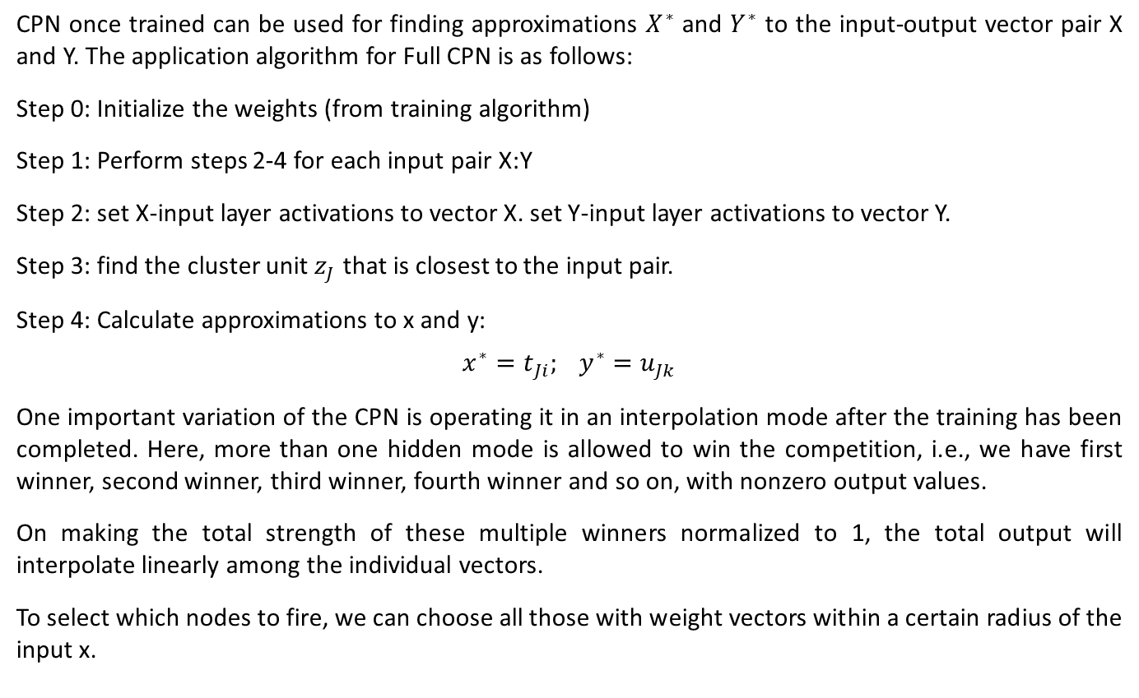
Testing Algorithm
CPN once trained can be used for finding approximations $X^{∗}$ and $Y^{∗}$ to the input-output vector pair X and Y. The application algorithm for Full CPN is as follows:
Step 0: Initialize the weights (from training algorithm)
Step 1: Perform steps 2-4 for each input pair X:Y
Step 2: set X-input layer activations to vector X. set Y-input layer activations to vector Y.
Step 3: find the cluster unit $z_{J}$ that is closest to the input pair.
Step 4: Calculate approximations to x and y:
$$x^{∗}=t_{Ji}; y^{∗}=u_{Jk}$$
One important variation of the CPN is operating it in an interpolation mode after the training has been completed. Here, more than one hidden mode is allowed to win the competition, i.e., we have first winner, second winner, third winner, fourth winner and so on, with nonzero output values.
On making the total strength of these multiple winners normalized to 1, the total output will interpolate linearly among the individual vectors.
To select which nodes to fire, we can choose all those with weight vectors within a certain radius of the input x.

Slide 33
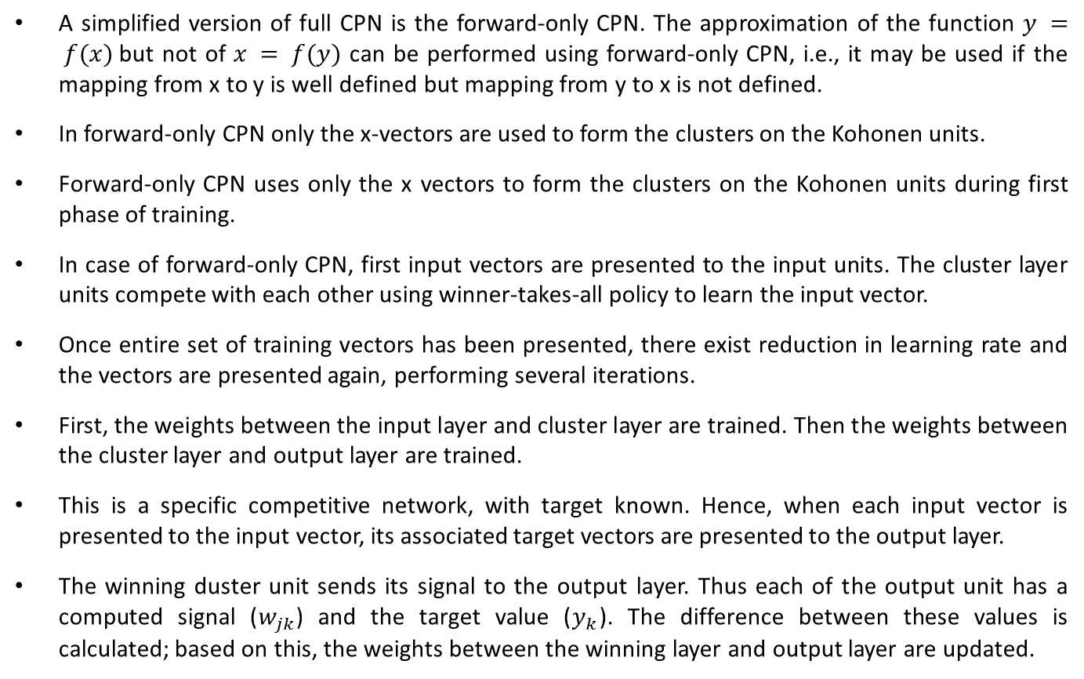
Forward-Only CPN
A simplified version of full CPN is the forward-only CPN. The approximation of the function $y = f(x)$but not of $x = f(y)$ can be performed using forward-only CPN, i.e., it may be used if the mapping from x to y is well defined but mapping from y to x is not defined.
In forward-only CPN only the x-vectors are used to form the clusters on the Kohonen units.
Forward-only CPN uses only the x vectors to form the clusters on the Kohonen units during first phase of training.
In case of forward-only CPN, first input vectors are presented to the input units. The cluster layer units compete with each other using winner-takes-all policy to learn the input vector.
Once entire set of training vectors has been presented, there exist reduction in learning rate and the vectors are presented again, performing several iterations.
First, the weights between the input layer and cluster layer are trained. Then the weights between the cluster layer and output layer are trained.
This is a specific competitive network, with target known. Hence, when each input vector is presented to the input vector, its associated target vectors are presented to the output layer.
The winning duster unit sends its signal to the output layer. Thus each of the output unit has a computed signal ($w_{jk}$) and the target value ($y_{k}$). The difference between these values is calculated; based on this, the weights between the winning layer and output layer are updated.

Slide 34
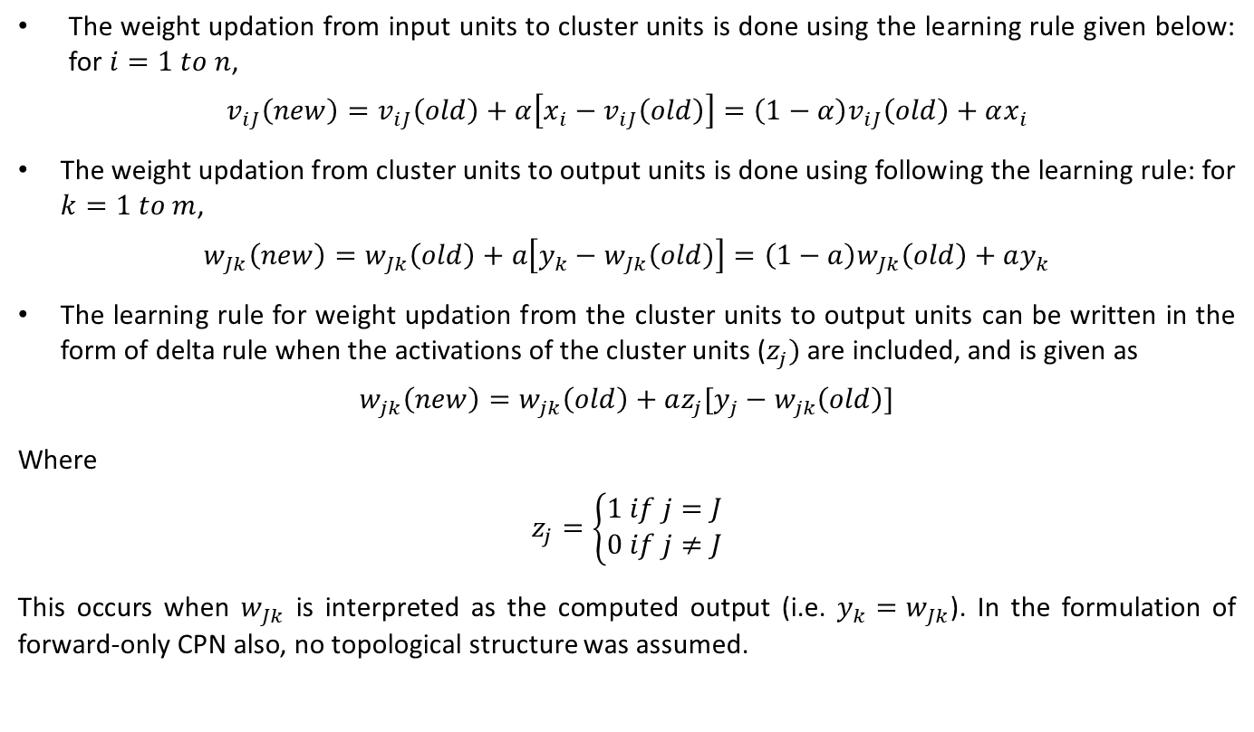
Forward-Only CPN
The weight updation from input units to cluster units is done using the learning rule given below: for $i=1 to n$,
$$v_{iJ}\left(new\right)=v_{iJ}\left(old\right)+α\left[x_{i}−v_{iJ}\left(old\right)\right]=\left(1−α\right)v_{iJ}\left(old\right)+αx_{i}$$
The weight updation from cluster units to output units is done using following the learning rule: for $k=1 to m$,
$$w_{Jk}\left(new\right)=w_{Jk}\left(old\right)+a\left[y_{k}−w_{Jk}\left(old\right)\right]=\left(1−a\right)w_{Jk}\left(old\right)+ay_{k}$$
The learning rule for weight updation from the cluster units to output units can be written in the form of delta rule when the activations of the cluster units ($z_{j})$ are included, and is given as
$$w_{jk}\left(new\right)=w_{jk}\left(old\right)+az_{j}[y_{j}−w_{jk}\left(old\right)]$$
Where
$$z_{j}=\left\{\begin{matrix}1 if j=J \\ 0 if j≠J\end{matrix}\right.$$
This occurs when $w_{Jk}$ is interpreted as the computed output (i.e. $y_{k}=w_{Jk}$). In the formulation of forward-only CPN also, no topological structure was assumed.

Slide 35
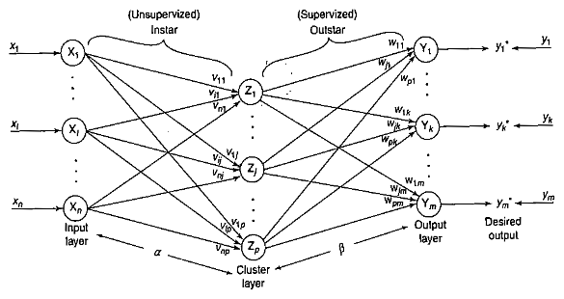
Forward-Only CPN (Architecture)
Figure shows the architecture of forward-only CPN. It consists of three layers: input layer, cluster (competitive) layer and output layer. The architecture of forward-only CPN resembles the back-propagation network, but in CPN there exists interconnections between the units in the cluster layer.
Once competition is completed in a forward-only CPN, only one unit will be active in that layer and it sends signal to the output layer. As inputs are presented to the network, the desired outputs will also be presented simultaneously.

Slide 36
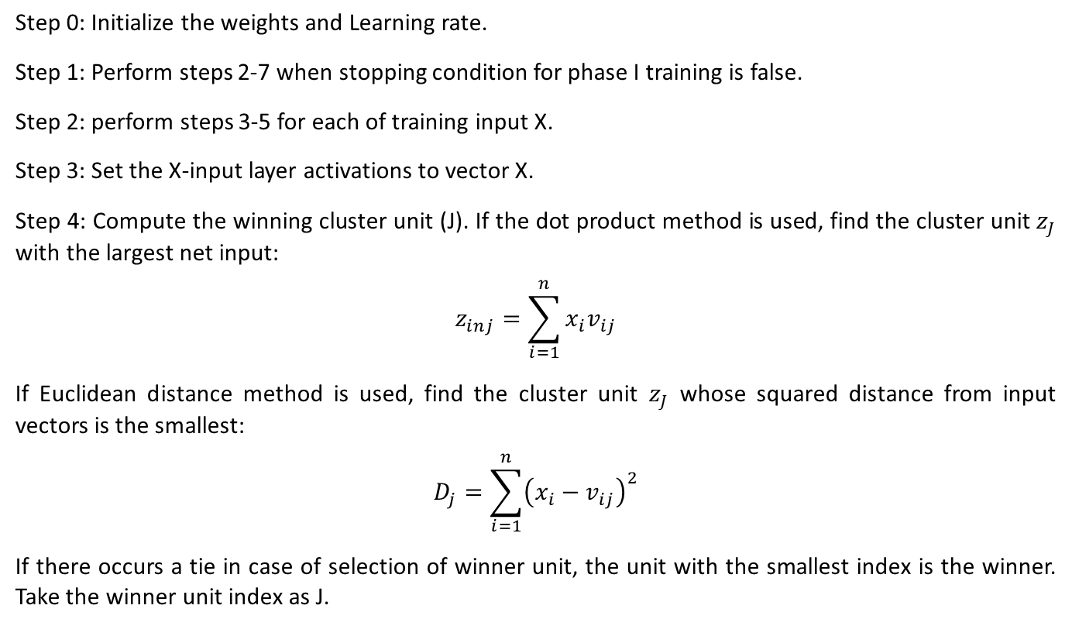
Forward-Only CPN (Training Algorithm)
Step 0: Initialize the weights and Learning rate.
Step 1: Perform steps 2-7 when stopping condition for phase I training is false.
Step 2: perform steps 3-5 for each of training input X.
Step 3: Set the X-input layer activations to vector X.
Step 4: Compute the winning cluster unit (J). If the dot product method is used, find the cluster unit $z_{J}$ with the largest net input:
$$z_{inj}=\sum_{i=1}^{n}{x_{i}v_{ij}}$$
If Euclidean distance method is used, find the cluster unit $z_{J}$ whose squared distance from input vectors is the smallest:
$$D_{j}=\sum_{i=1}^{n}{{\left(x_{i}−v_{ij}\right)}^{2}}$$
If there occurs a tie in case of selection of winner unit, the unit with the smallest index is the winner. Take the winner unit index as J.

Slide 37
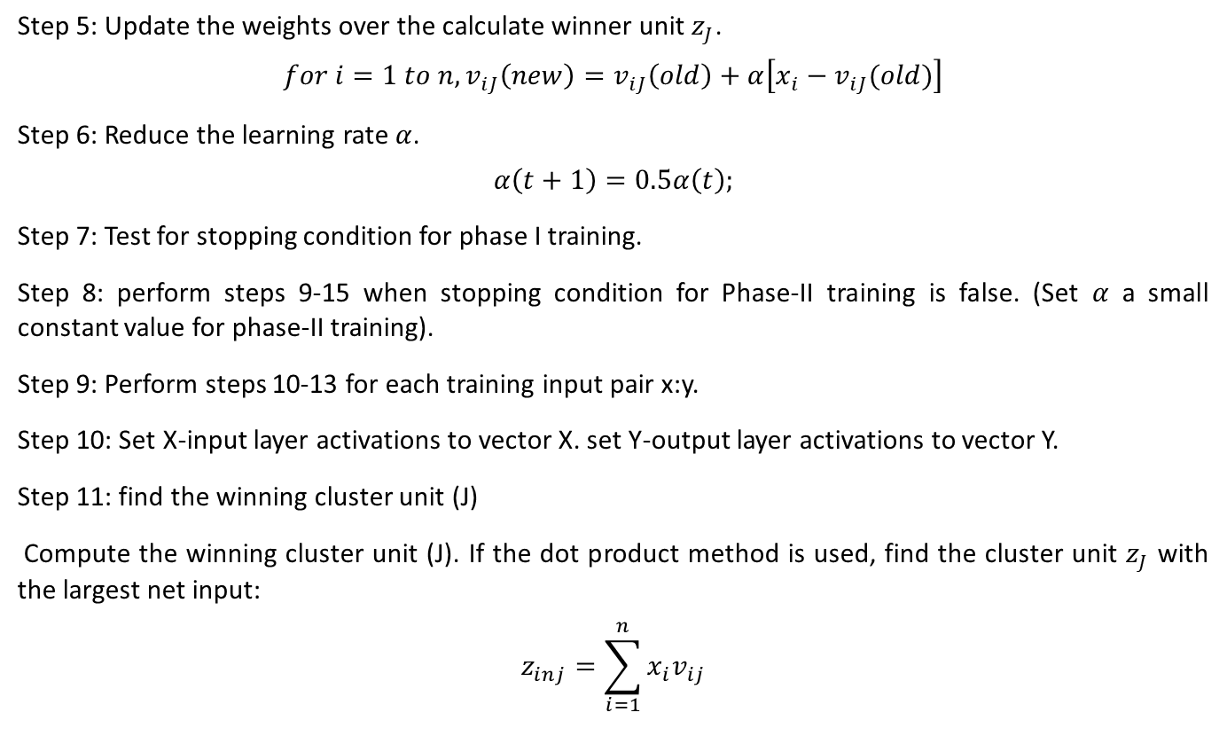
Forward-Only CPN (Training Algorithm)
Step 5: Update the weights over the calculate winner unit $z_{J}$.
$$for i=1 to n, v_{iJ}\left(new\right)=v_{iJ}\left(old\right)+α\left[x_{i}−v_{iJ}(old)\right]$$
Step 6: Reduce the learning rate $α$.
$$α\left(t+1\right)=0.5α\left(t\right);$$
Step 7: Test for stopping condition for phase I training.
Step 8: perform steps 9-15 when stopping condition for Phase-II training is false. (Set $α$ a small constant value for phase-II training).
Step 9: Perform steps 10-13 for each training input pair x:y.
Step 10: Set X-input layer activations to vector X. set Y-output layer activations to vector Y.
Step 11: find the winning cluster unit (J)
Compute the winning cluster unit (J). If the dot product method is used, find the cluster unit $z_{J}$ with the largest net input:
$$z_{inj}=\sum_{i=1}^{n}{x_{i}v_{ij}}$$

Slide 38
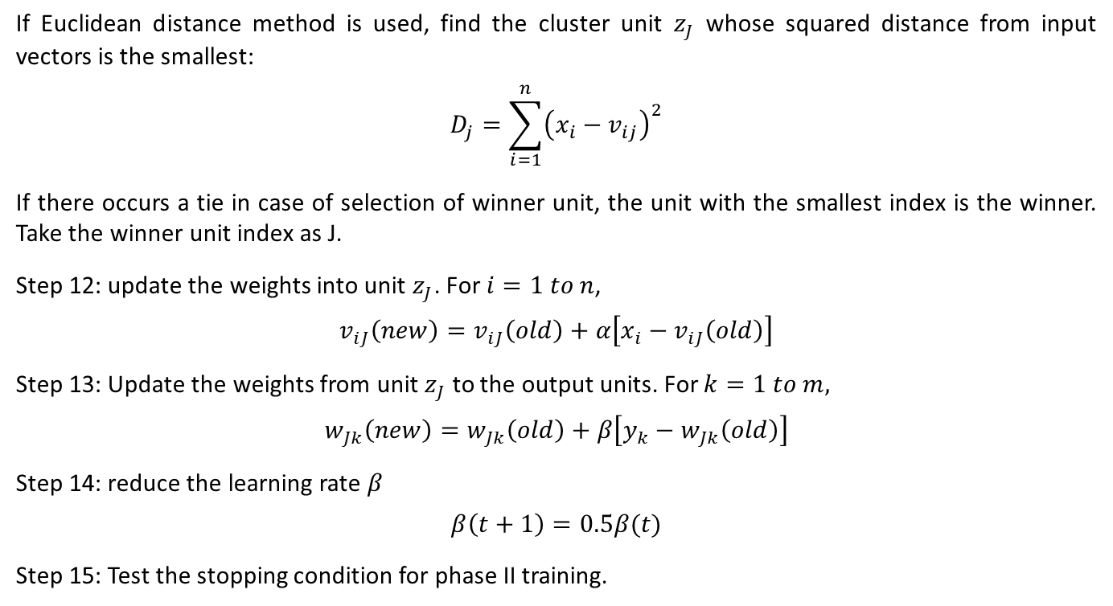
Forward-Only CPN (Training Algorithm)
If Euclidean distance method is used, find the cluster unit $z_{J}$ whose squared distance from input vectors is the smallest:
$$D_{j}=\sum_{i=1}^{n}{{\left(x_{i}−v_{ij}\right)}^{2}}$$
If there occurs a tie in case of selection of winner unit, the unit with the smallest index is the winner. Take the winner unit index as J.
Step 12: update the weights into unit $z_{J}$. For $i=1 to n$,
$$v_{iJ}\left(new\right)=v_{iJ}\left(old\right)+α\left[x_{i}−v_{iJ}\left(old\right)\right]$$
Step 13: Update the weights from unit $z_{J}$ to the output units. For $k=1 to m,$
$$w_{Jk}\left(new\right)=w_{Jk}\left(old\right)+β\left[y_{k}−w_{Jk}\left(old\right)\right]$$
Step 14: reduce the learning rate $β$
$$β\left(t+1\right)=0.5β(t)$$
Step 15: Test the stopping condition for phase II training.

Slide 39
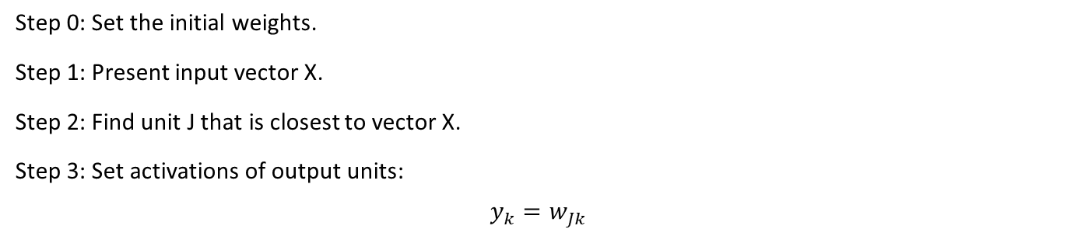
Forward-Only CPN (Testing Algorithm)
Step 0: Set the initial weights.
Step 1: Present input vector X.
Step 2: Find unit J that is closest to vector X.
Step 3: Set activations of output units:
$$y_{k}=w_{Jk}$$

Slide 40
Adaptive Resonance Theory Network
The adaptive resonance theory (ART) network, developed by steven Grossberg and Gail Carpenter (1987), is consistent with behavioral models.
This is an unsupervised learning, based on competition, that finds categories autonomously and learns new categories if needed.
The adaptive resonance model was developed to solve the problem of instability occurring in feedforward systems.
There are two types of ART: ART 1 and ART 2. ART 1 is designed for clustering binary vectors and ART 2 is designed to accept continuous-valued vectors.
In both the nets, input patterns can be presented in any order. For each pattern, presented to the network an appropriate cluster unit is chosen and the weights of the cluster unit are adjusted to let the cluster unit learn the pattern.
This network controls the degree of similarity of the patterns placed on the same cluster units.
During training, each training pattern may be presented several times. It should be noted that the input patterns should not be presented on the same cluster unit, when it is presented each time.
On the basis of this, the stability of the net is defined as that wherein pattern is not presented to previous cluster units.

Slide 41
Adaptive Resonance Theory Network
The stability may be achieved by reducing the learning rates. The ability of the network to respond to a new pattern equally at any stage of learning is called as plasticity.
ART nets are designed to possess the properties, stability and plasticity.
The key concept of ART is that the stability plasticity can be resolved by a system in which the network includes bottom-up (input-output) competitive learning combined with top-down (output-input) learning.
The instability of instar-outstar networks could be solved by reducing the learning rate gradually to zero by freezing the learned categories.
But, at this point, the net may lose its plasticity or the ability to react to new data.
Thus it is difficult to possess both stability and plasticity.
ART networks are designed particularly to resolve the stability-plasticity dilemma, that is, they are stable to preserve significant past learning but nevertheless remain adaptable to incorporate new information whenever it appears.

Slide 42
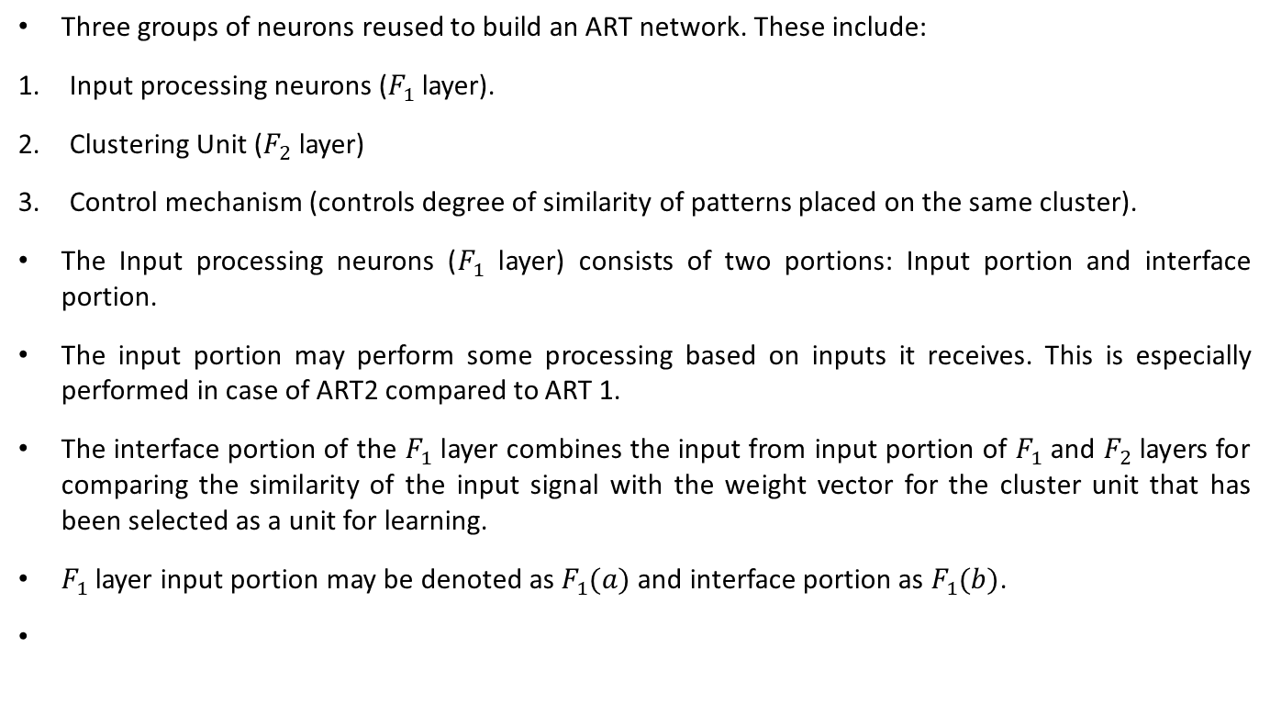
Fundamental Architecture
Three groups of neurons reused to build an ART network. These include:
Input processing neurons ($F_{1}$ layer).
Clustering Unit ($F_{2}$ layer)
Control mechanism (controls degree of similarity of patterns placed on the same cluster).
The Input processing neurons ($F_{1}$ layer) consists of two portions: Input portion and interface portion.
The input portion may perform some processing based on inputs it receives. This is especially performed in case of ART2 compared to ART 1.
The interface portion of the $F_{1}$ layer combines the input from input portion of $F_{1}$ and $F_{2}$ layers for comparing the similarity of the input signal with the weight vector for the cluster unit that has been selected as a unit for learning.
$F_{1}$ layer input portion may be denoted as $F_{1}(a)$ and interface portion as $F_{1}(b)$.

Slide 43
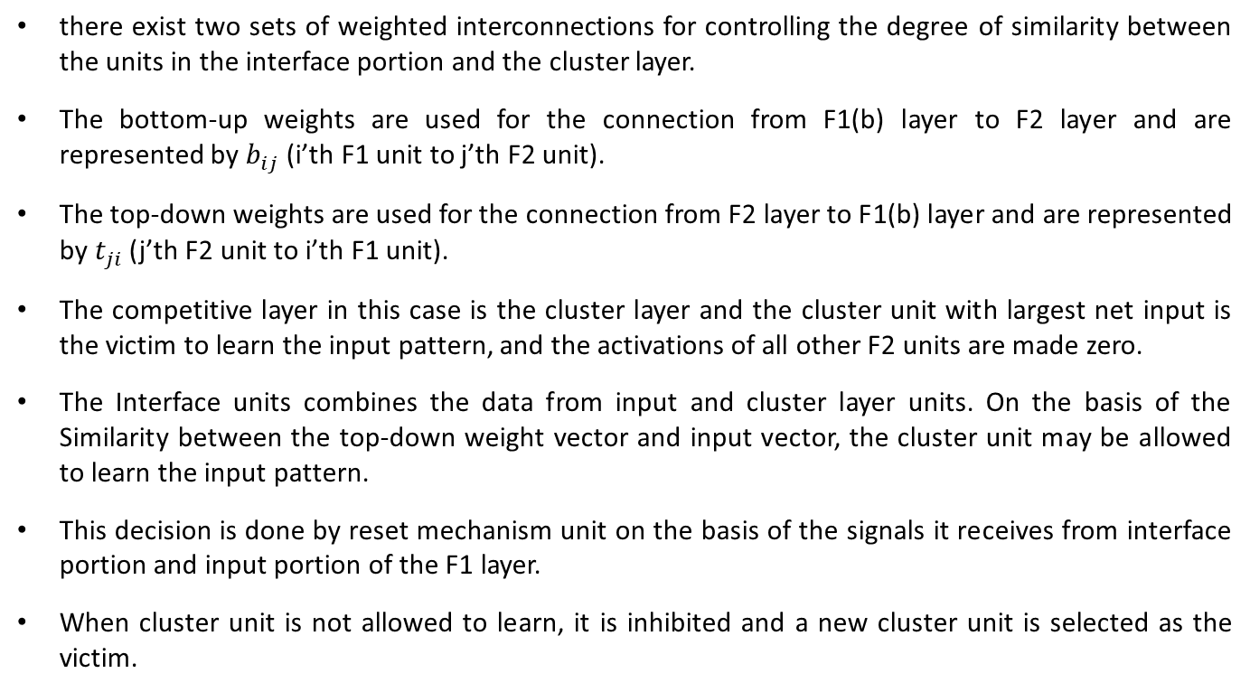
Fundamental Architecture
there exist two sets of weighted interconnections for controlling the degree of similarity between the units in the interface portion and the cluster layer.
The bottom-up weights are used for the connection from F1(b) layer to F2 layer and are represented by $b_{ij}$ (i’th F1 unit to j’th F2 unit).
The top-down weights are used for the connection from F2 layer to F1(b) layer and are represented by $t_{ji}$ (j’th F2 unit to i’th F1 unit).
The competitive layer in this case is the cluster layer and the cluster unit with largest net input is the victim to learn the input pattern, and the activations of all other F2 units are made zero.
The Interface units combines the data from input and cluster layer units. On the basis of the Similarity between the top-down weight vector and input vector, the cluster unit may be allowed to learn the input pattern.
This decision is done by reset mechanism unit on the basis of the signals it receives from interface portion and input portion of the F1 layer.
When cluster unit is not allowed to learn, it is inhibited and a new cluster unit is selected as the victim.

Slide 44
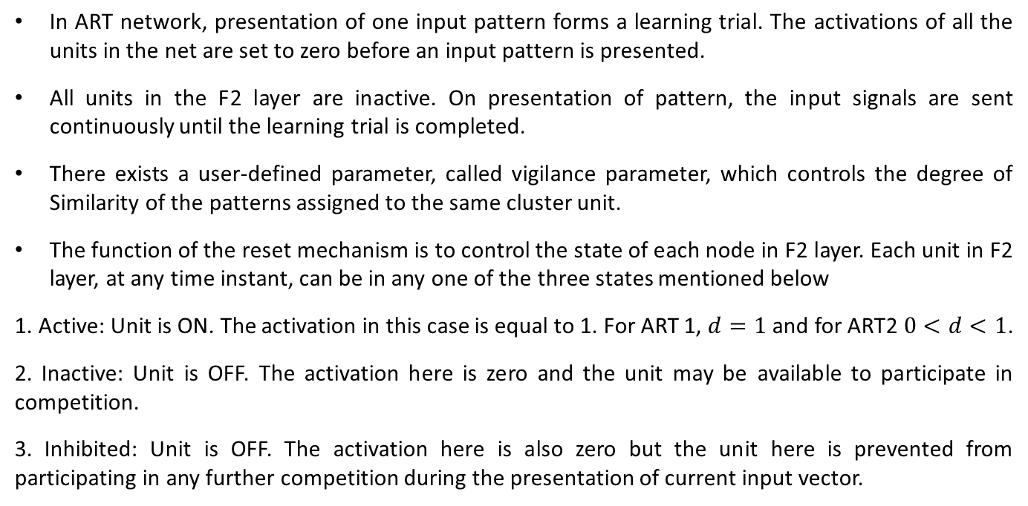
Fundamental Operating Principle
In ART network, presentation of one input pattern forms a learning trial. The activations of all the units in the net are set to zero before an input pattern is presented.
All units in the F2 layer are inactive. On presentation of pattern, the input signals are sent continuously until the learning trial is completed.
There exists a user-defined parameter, called vigilance parameter, which controls the degree of Similarity of the patterns assigned to the same cluster unit.
The function of the reset mechanism is to control the state of each node in F2 layer. Each unit in F2 layer, at any time instant, can be in any one of the three states mentioned below
1. Active: Unit is ON. The activation in this case is equal to 1. For ART 1, $d=1$and for ART2 $0<d<1$.
2. Inactive: Unit is OFF. The activation here is zero and the unit may be available to participate in competition.
3. Inhibited: Unit is OFF. The activation here is also zero but the unit here is prevented from participating in any further competition during the presentation of current input vector.

Slide 45
Fundamental Operating Principle
The ART nets can perform their learning in two ways: Fast learning and slow learning.
The weight updation takes place rapidly in fast learning, relative to the length of time a pattern is being presented on any particular learning trial. In fast learning, the weights reach equilibrium in each trial.
On the contrary in slow learning the weight change occurs slowly relative to the time taken for a learning trial and the weights do not reach equilibrium in each trial.
More patterns have to be presented for slow learning compared to that for fast learning.
For each learning trial, there occurs only minimum number of calculations in slow learning.
In case of fast learning, the net is considered to be stabilized when each pattern closes its correct cluster unit.
The pattern are binary in ART1 network, hence the weights associated with each cluster unit stabilize in the fast learning mode.
The weight vectors obtain are appropriate for the type of input patterns used in ART 1.
In case of ART 2 network, the weights produced by fast learning continue to change each time a pattern is presented.

Slide 46
Fundamental Operating Principle
The net is found to stabilize only after few presentations of each training pattern.
It is not easy to find equilibrium weights immediately for ART2 as it is for ART1.
In slow learning process, the weight changes do not reach equilibrium during any particular learning trial and more trials are required before the net stabilizes.
Slow learning is generally not adopted for ART 1.
For ART 2, the weights produced by slow learning are far better than those produced by fast learning for particular types of data.

Slide 47
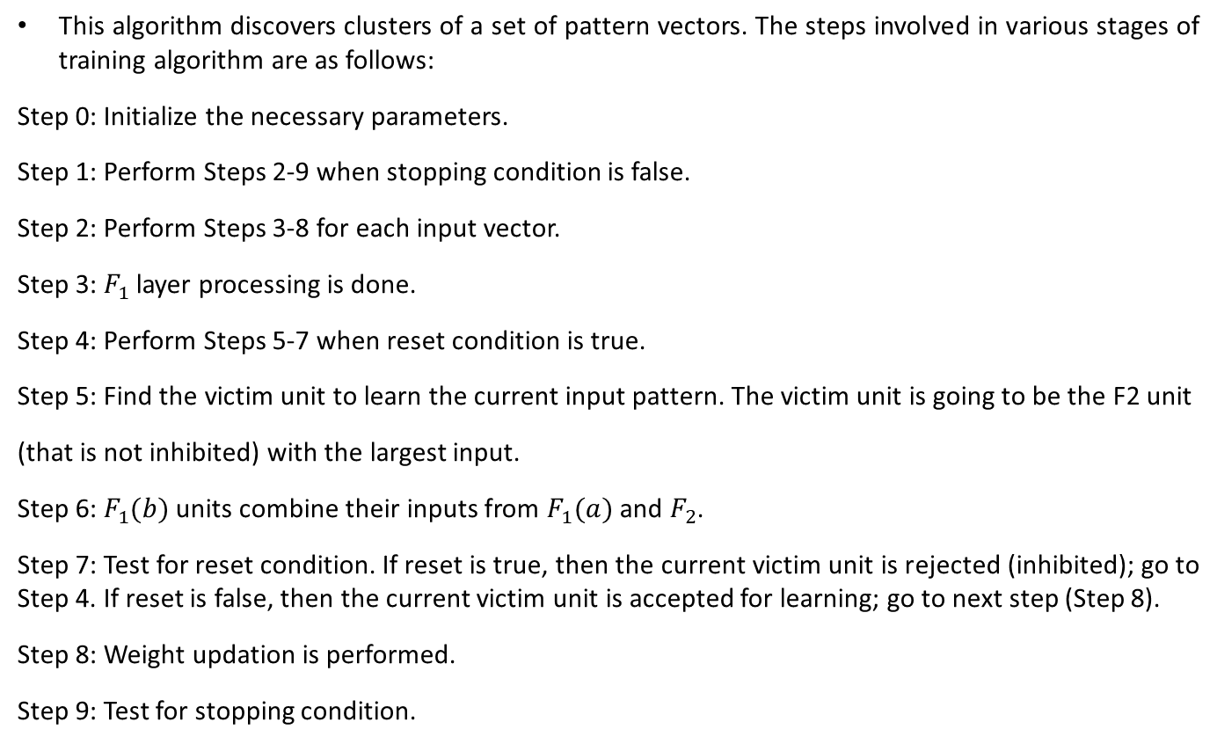
Fundamental Algorithm
This algorithm discovers clusters of a set of pattern vectors. The steps involved in various stages of training algorithm are as follows:
Step 0: Initialize the necessary parameters.
Step 1: Perform Steps 2-9 when stopping condition is false.
Step 2: Perform Steps 3-8 for each input vector.
Step 3: $F_{1}$ layer processing is done.
Step 4: Perform Steps 5-7 when reset condition is true.
Step 5: Find the victim unit to learn the current input pattern. The victim unit is going to be the F2 unit
(that is not inhibited) with the largest input.
Step 6: $F_{1}(b)$ units combine their inputs from $F_{1}(a)$ and $F_{2}$.
Step 7: Test for reset condition. If reset is true, then the current victim unit is rejected (inhibited); go to Step 4. If reset is false, then the current victim unit is accepted for learning; go to next step (Step 8).
Step 8: Weight updation is performed.
Step 9: Test for stopping condition.

Slide 48
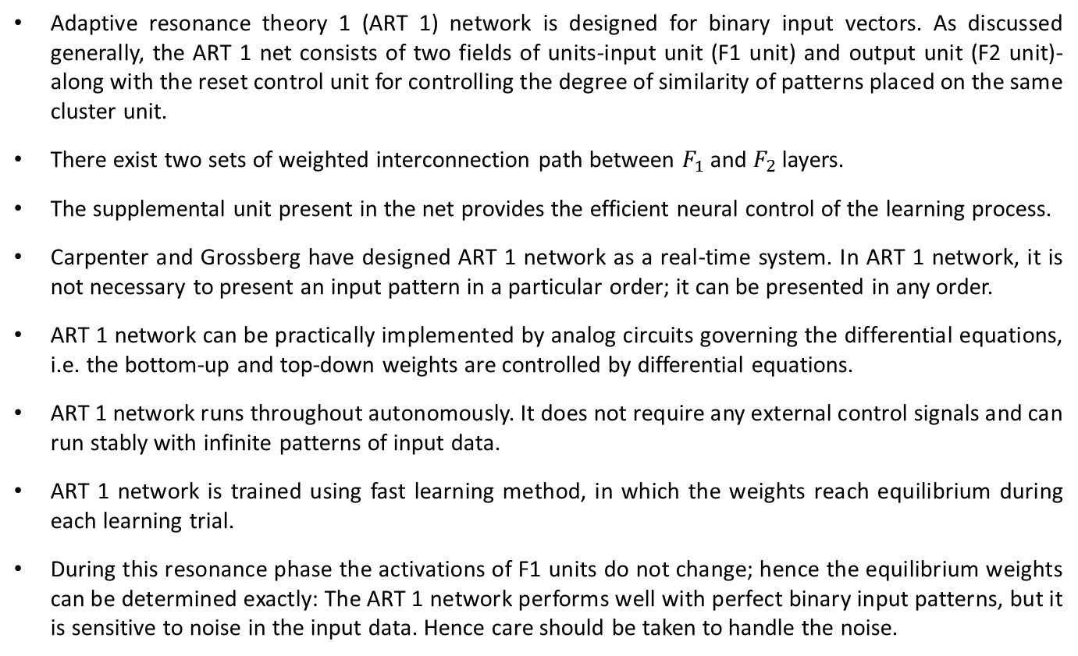
Adaptive Resonance Theory 1
Adaptive resonance theory 1 (ART 1) network is designed for binary input vectors. As discussed generally, the ART 1 net consists of two fields of units-input unit (F1 unit) and output unit (F2 unit)-along with the reset control unit for controlling the degree of similarity of patterns placed on the same cluster unit.
There exist two sets of weighted interconnection path between $F_{1}$ and $F_{2}$ layers.
The supplemental unit present in the net provides the efficient neural control of the learning process.
Carpenter and Grossberg have designed ART 1 network as a real-time system. In ART 1 network, it is not necessary to present an input pattern in a particular order; it can be presented in any order.
ART 1 network can be practically implemented by analog circuits governing the differential equations, i.e. the bottom-up and top-down weights are controlled by differential equations.
ART 1 network runs throughout autonomously. It does not require any external control signals and can run stably with infinite patterns of input data.
ART 1 network is trained using fast learning method, in which the weights reach equilibrium during each learning trial.
During this resonance phase the activations of F1 units do not change; hence the equilibrium weights can be determined exactly: The ART 1 network performs well with perfect binary input patterns, but it is sensitive to noise in the input data. Hence care should be taken to handle the noise.

Slide 49
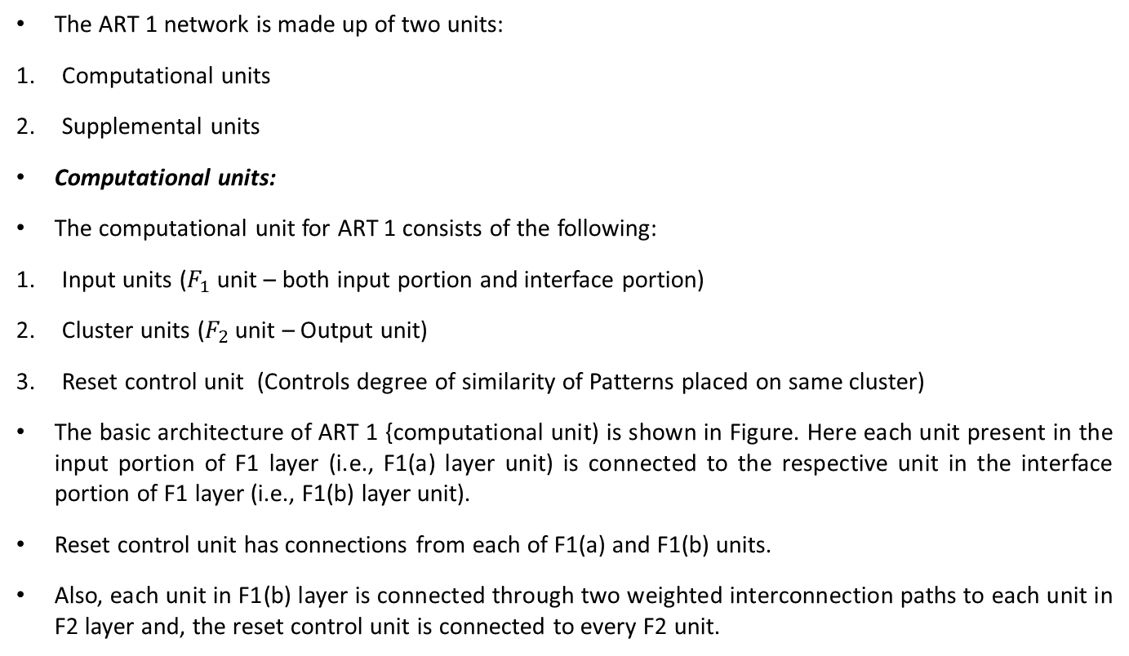
Architecture
The ART 1 network is made up of two units:
Computational units
Supplemental units
Computational units:
The computational unit for ART 1 consists of the following:
Input units ($F_{1}$ unit – both input portion and interface portion)
Cluster units ($F_{2}$ unit – Output unit)
Reset control unit (Controls degree of similarity of Patterns placed on same cluster)
The basic architecture of ART 1 {computational unit) is shown in Figure. Here each unit present in the input portion of F1 layer (i.e., F1(a) layer unit) is connected to the respective unit in the interface portion of F1 layer (i.e., F1(b) layer unit).
Reset control unit has connections from each of F1(a) and F1(b) units.
Also, each unit in F1(b) layer is connected through two weighted interconnection paths to each unit in F2 layer and, the reset control unit is connected to every F2 unit.

Slide 50
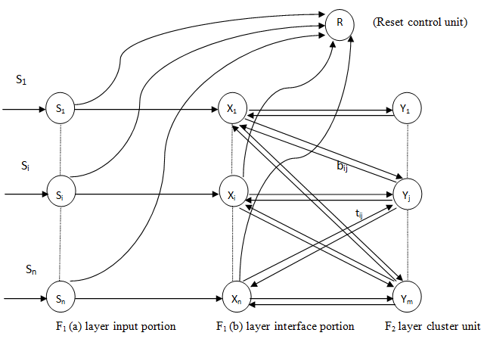

Slide 51
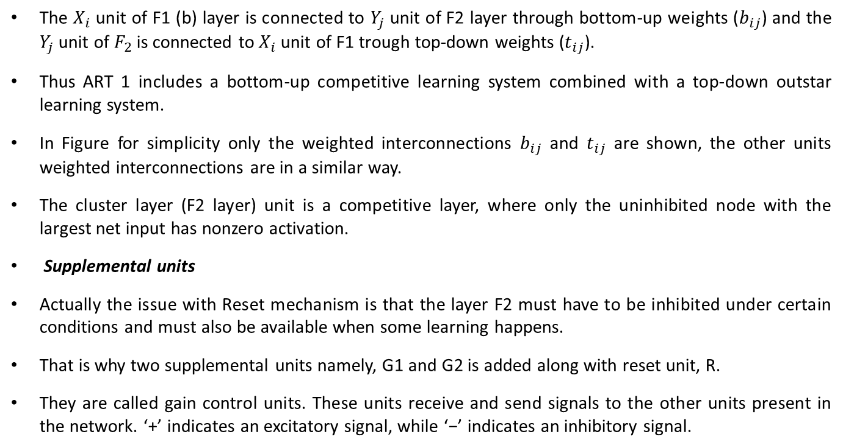
Architecture
The $X_{i}$ unit of F1 (b) layer is connected to $Y_{j}$ unit of F2 layer through bottom-up weights ($b_{ij}$) and the $Y_{j}$ unit of $F_{2}$ is connected to $X_{i}$ unit of F1 trough top-down weights ($t_{ij}$).
Thus ART 1 includes a bottom-up competitive learning system combined with a top-down outstar learning system.
In Figure for simplicity only the weighted interconnections $b_{ij}$ and $t_{ij}$ are shown, the other units weighted interconnections are in a similar way.
The cluster layer (F2 layer) unit is a competitive layer, where only the uninhibited node with the largest net input has nonzero activation.
Supplemental units
Actually the issue with Reset mechanism is that the layer F2 must have to be inhibited under certain conditions and must also be available when some learning happens.
That is why two supplemental units namely, G1 and G2 is added along with reset unit, R.
They are called gain control units. These units receive and send signals to the other units present in the network. ‘+’ indicates an excitatory signal, while ‘−’ indicates an inhibitory signal.

Slide 52
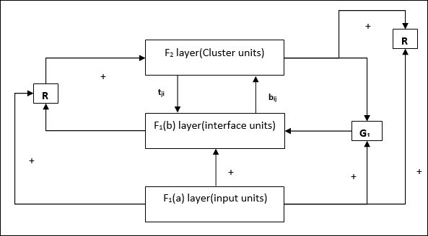

Slide 53
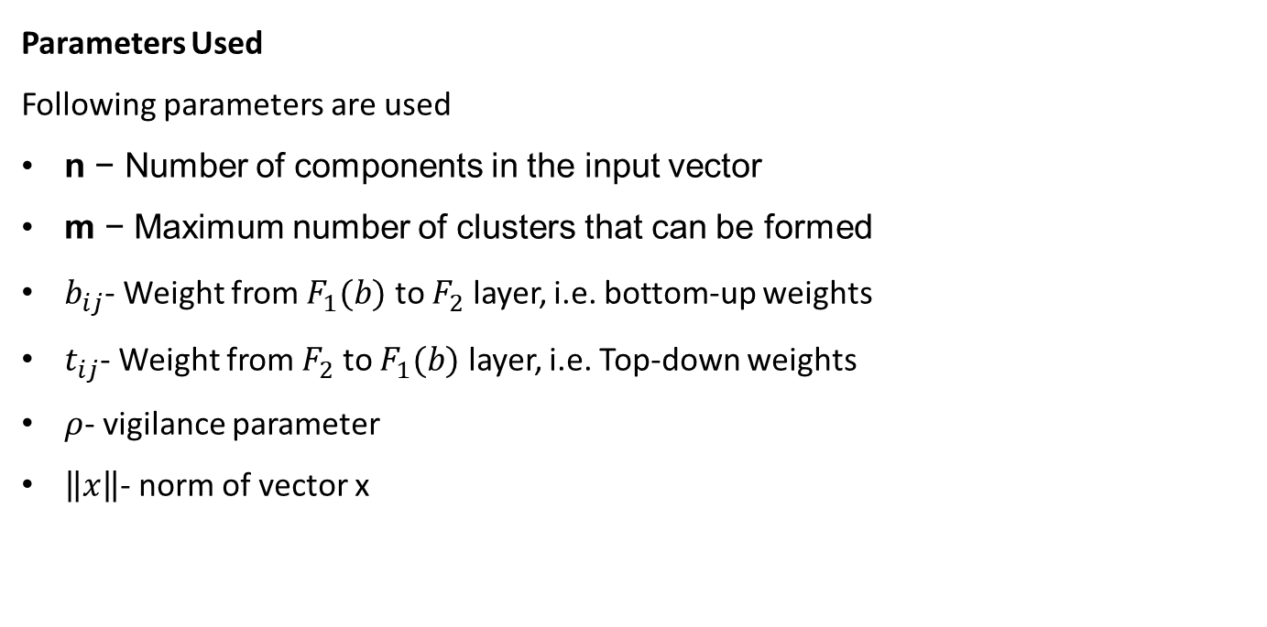
Algorithm
Parameters Used
Following parameters are used
n − Number of components in the input vector
m − Maximum number of clusters that can be formed
$b_{ij}$- Weight from $F_{1}(b)$ to $F_{2}$ layer, i.e. bottom-up weights
$t_{ij}$- Weight from $F_{2}$ to $F_{1}(b)$ layer, i.e. Top-down weights
$ρ$- vigilance parameter
$\left\|x\right\|$- norm of vector x

Slide 54
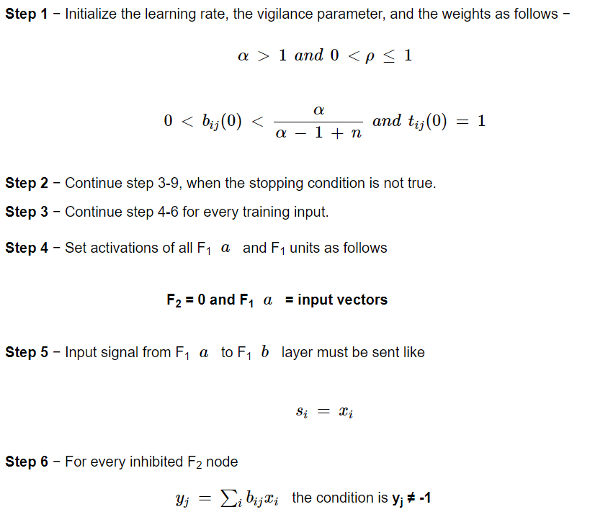
Algorithm

Slide 55
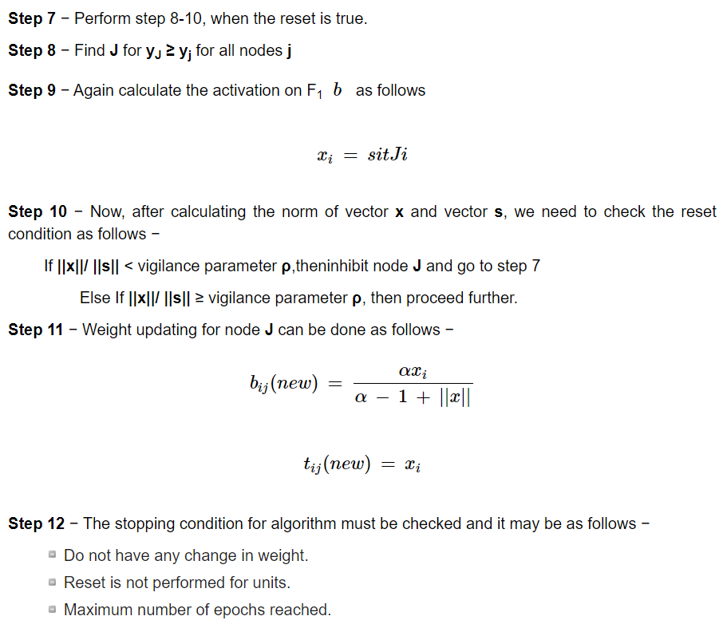
Algorithm

Slide 56

Example
Construct an ART 1 network for clustering four input vectors with low vigilance parameter of 0.4 into three clusters. The four input vectors are $\left[\begin{matrix}\begin{matrix}0 & 0\end{matrix} & \begin{matrix}0 & 1\end{matrix}\end{matrix}\right]$, $\left[\begin{matrix}\begin{matrix}0 & 1\end{matrix} & \begin{matrix}0 & 1\end{matrix}\end{matrix}\right]$, $\left[\begin{matrix}\begin{matrix}0 & 0\end{matrix} & \begin{matrix}1 & 1\end{matrix}\end{matrix}\right]$ and $\left[\begin{matrix}\begin{matrix}1 & 0\end{matrix} & \begin{matrix}0 & 0\end{matrix}\end{matrix}\right]$. Assume the necessary parameters needed.
Solution: the value assumed in this case are $ρ=0.4$, $α=2$.
Also it can be noted that n=4 and m=3. Hence Bottom-up weights $b_{ij}\left(0\right)=\frac{1}{1+n}=\frac{1}{1+4}=0.2$ Top-Down weights $t_{ij}\left(0\right)=1$
For $i= 1 to 4$and $j=1 to 2$
$b_{ij}=\left[\begin{matrix}\begin{matrix}\begin{matrix}0.2 \\ 0.2\end{matrix} \\ \begin{matrix}0.2 \\ 0.2\end{matrix}\end{matrix} & \begin{matrix}\begin{matrix}0.2 \\ 0.2\end{matrix} \\ \begin{matrix}0.2 \\ 0.2\end{matrix}\end{matrix} & \begin{matrix}\begin{matrix}0.2 \\ 0.2\end{matrix} \\ \begin{matrix}0.2 \\ 0.2\end{matrix}\end{matrix}\end{matrix}\right]$ and $t_{ji}=\left[\begin{matrix}\begin{matrix}\begin{matrix}1 & 1\end{matrix} & \begin{matrix}1 & 1\end{matrix}\end{matrix} \\ \begin{matrix}\begin{matrix}1 & 1\end{matrix} & \begin{matrix}1 & 1\end{matrix}\end{matrix} \\ \begin{matrix}\begin{matrix}1 & 1\end{matrix} & \begin{matrix}1 & 1\end{matrix}\end{matrix}\end{matrix}\right]$

Slide 57



Slide 58



